Slide 1


Lunar ROADSTER
(Robotic Operator for Autonomous Development of Surface Trails and Exploration Routes)
“Starting with a foothold on the Moon, we pave the way to the cosmos”

Slide 2
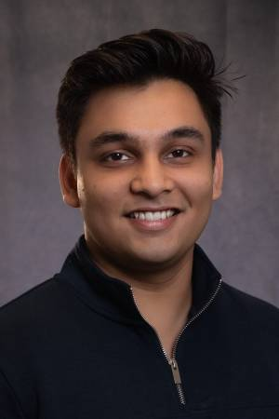


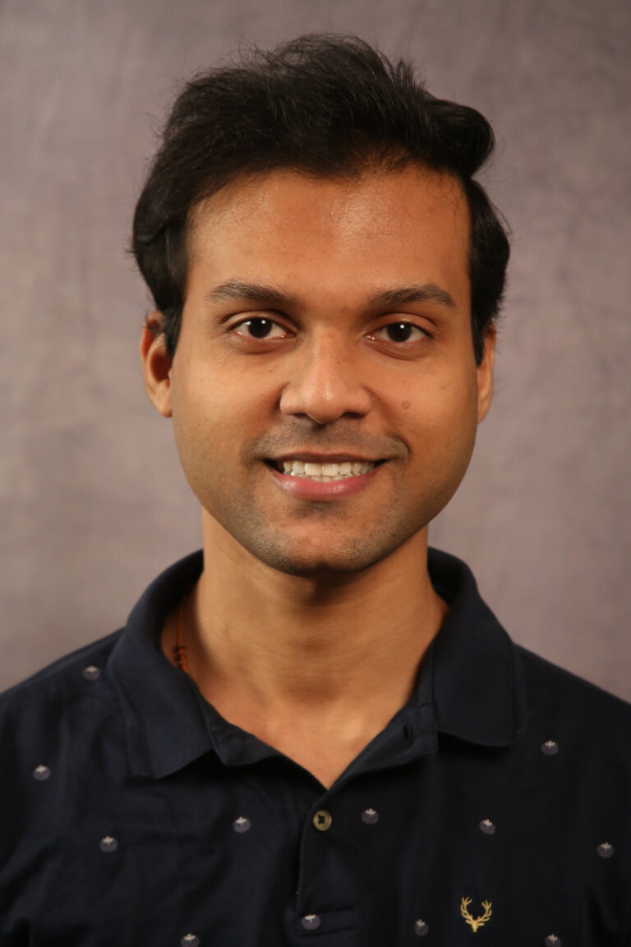


The Team
Ankit Aggarwal
Deepam Ameria
Bhaswanth Ayapilla
Simson D’Souza
Boxiang (William) Fu
Dr. William “Red” Whittaker
Notes:
-Introduce team

Slide 3
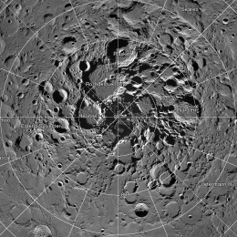
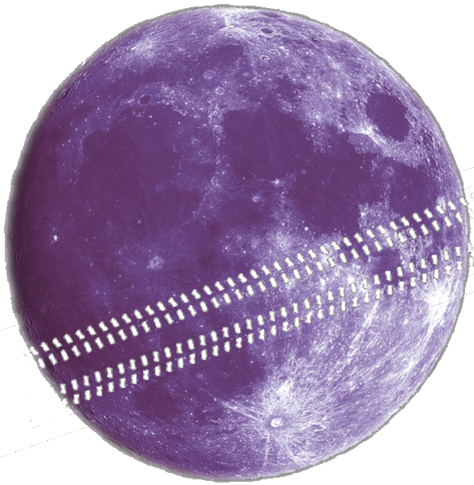
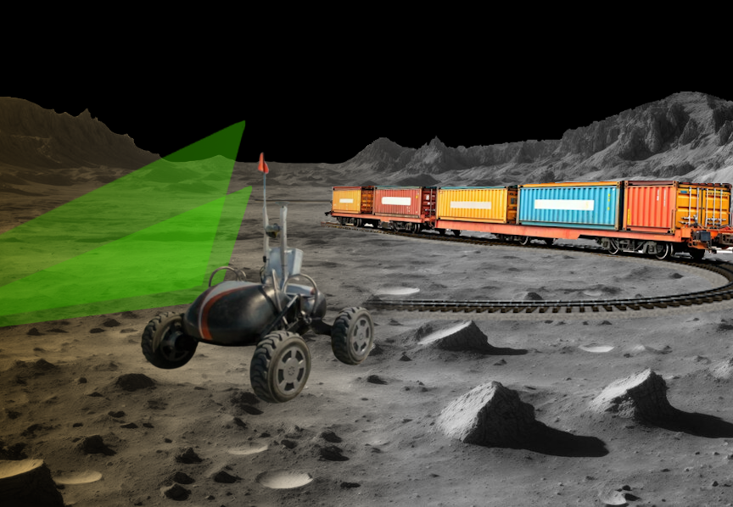
Motivation: The Lunar Polar Highway
CIRCUMNAV
Is it possible for a solar-powered rover to repeatedly drive around the Moon and never encounter a sunset?
Notes:
Humanity is returning to the Moon, particularly the south pole, as a long-term outpost.
For sustainable exploration, we need reliable infrastructure—starting with a traversable route.

Slide 4
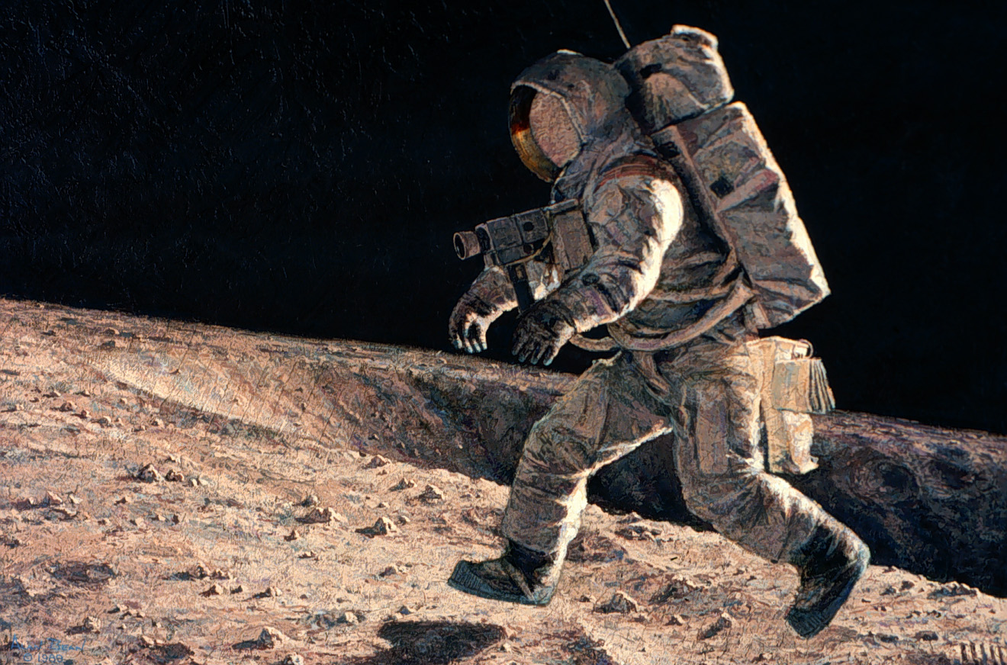
Motivation: The Lunar Polar Highway
Sun-synchronous circumnavigation around Moon at 28 days x 24 hr = 672 hour sun rotation
Jogging speed if the route was flat, circular and traversable
At equator 11,000 km 16 kph
At 50 deg 7,040 km 10 kph
At 60 deg 5,500 km 8 kph
At 70 deg 3,700 km 6 kph
At 75 deg 2,800 km 4 kph
At 80 deg 1,870 km 3 kph
At 81 deg 1,529 km 2.5 kph
Notes:
Turns out, at 75° latitude, a rover can achieve sun-synchronous circumnavigation around the pole at just 4 km/h(that’s literally just walking jogging speed).
But this assumes a flat, nearly circular path—something that doesn’t exist naturally. That’s where our project comes in.

Slide 5
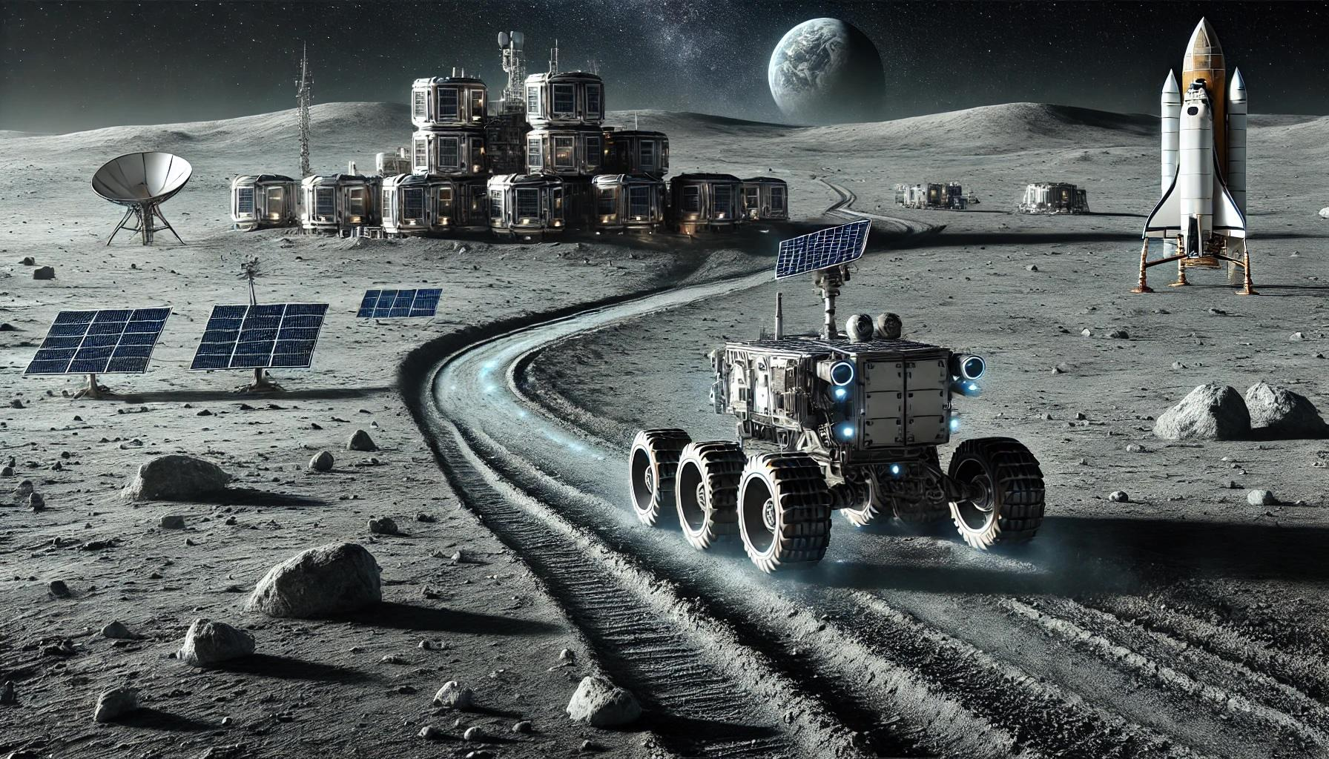
The Project: Lunar ROADSTER
An autonomous moon-working rover capable of finding ideal exploration routes and creating traversable surface trails.
By grooming trail paths, rovers with less traversing capabilities will be able to travel at higher speeds and higher power efficiencies.
A traversable and circuitous trail path will allow rovers to maintain sun-synchronicity, thereby allowing machines to run for much longer.
The groomed trails will become the backbone for colonization of the Moon by enabling transportation, logistics and enterprise development.
Notes:
Lunar ROADSTER
Autonomous Moon-working rover, capable of finding optimal exploration routes and creating traversable surface trails (30)

Slide 6
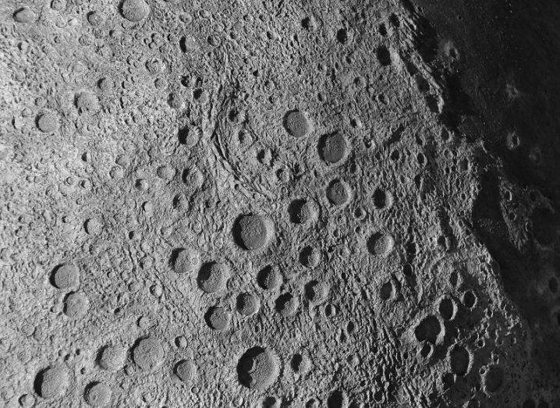
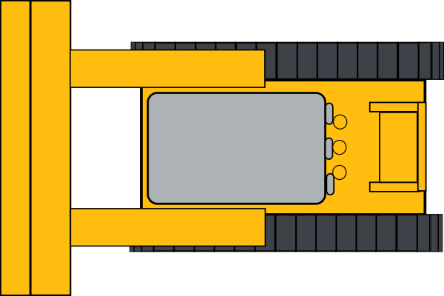
Use Case: Circular Path Grooming
Lunar ROADSTER
Reference Latitude
Groomed Path
Crater to Avoid
Original Traversable Path
Craters to Groom
Notes:
This is our primary use case. The dotted line represents a chosen latitude, the blue path represents the original, rough, circuitous path
The green lines represent the groomed path that makes the original path much safer, direct and energy-efficient for solar powered rovers.
The rover will create this path while grooming certain craters in its path, while avoiding big/deep craters

Slide 7
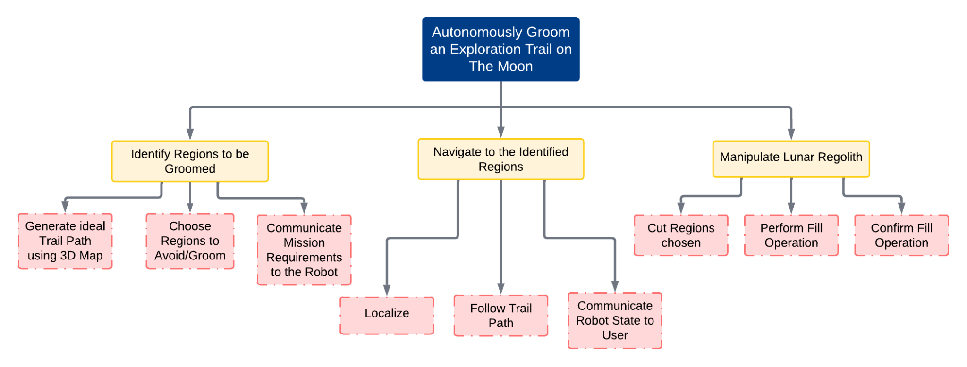
Objectives Tree
Notes:
Our work is structured into three main objectives, each with specific sub-objectives, ensuring a methodical approach
My colleagues will now dig deeper on these objectives. Over to you Simson.

Slide 8
Functional Requirements (Mandatory)
Sr. No. | Mandatory Functional Requirement
M.F.1 | Shall perform trail path planning
M.F.2 | Shall operate autonomously
M.F.3 | Shall localize itself in a GPS denied environment
M.F.4 | Shall navigate the planned path
M.F.5 | Shall traverse uneven terrain
M.F.6 | Shall choose craters to groom and avoid
M.F.7 | Shall grade craters and level dunes
M.F.8 | Shall validate grading and trail path
M.F.9 | Shall communicate with the user
Notes:
FR1 - off board on the moon station (laptops)
FR2, FR3, FR4 - Mission requirements communicated, robot localizes, navigates autonomously
FR5 - Physical capability
FR6, FR7 - Path planning -> Tool planning - manipulation
FR8 - Validation -> sensor suite
FR9 - Communication infrastructure

Slide 9
Non-Functional Requirements (Mandatory)
Sr. No. | Parameter | Description
M.N.1 | Weight | The rover must weigh under 50kg
M.N.2 | Cost | The cost for the project must be under $5000
M.N.3 | Computing Capacity | The onboard computer should be able to run all required tasks
M.N.4 | Size/Form Factor | The rover should measure less than 1m in all dimensions
Notes:
NFM1 - Align with the performance requirements
NFM2 - MRSD Project Budget
NFM3- Onboard computing - Localization, Tool Planning, Navigation, Validation
NFM4 - Moon Pit, 5x5, NFM1

Slide 10
Non-Functional Requirements (Desirable)
Sr. No. | Parameter | Description
D.N.1 | Technological Extensibility | The system will be well documented and designed so that future teams can easily access and build on the work
D.N.2 | Aesthetics | Requirement from sponsor, the rover must look presentable and lunar-ready
D.N.3 | Modularity | To enable tool interchangeability, the tool assemblies must be modular and easy to assemble/disassemble
D.N.4 | Repeatability | The system will complete multiple missions without the need of maintenance
Notes:
NFD1 - Well structured and documented for future
NFD2 - Unique sponsor requirement
NFD3 - Want our robot to be modular, have easily changeable manipulators/tools, adjustable to similar other missions
NFD4 - Want it to be able to perform the missions multiple times, thus improving robustness

Slide 11
Performance Requirements (Mandatory)
Sr. No. | Performance Metrics
M.P.1 | Will plan a path with cumulative deviation of <= 25% from chosen latitude’s length
M.P.2 | Will follow planned path to a maximum deviation of 10%
M.P.3 | Will climb gradients up to 15° and have a contact pressure of less than 1.5 kPa
M.P.4 | Will avoid craters >= 0.5 metres and avoid slopes >= 15°
M.P.5 | Will fill craters of up to 0.5 meters in diameter and 0.1m in depth
M.P.6 | Will groom the trail to have a maximum traversal slope of 5°

Slide 12
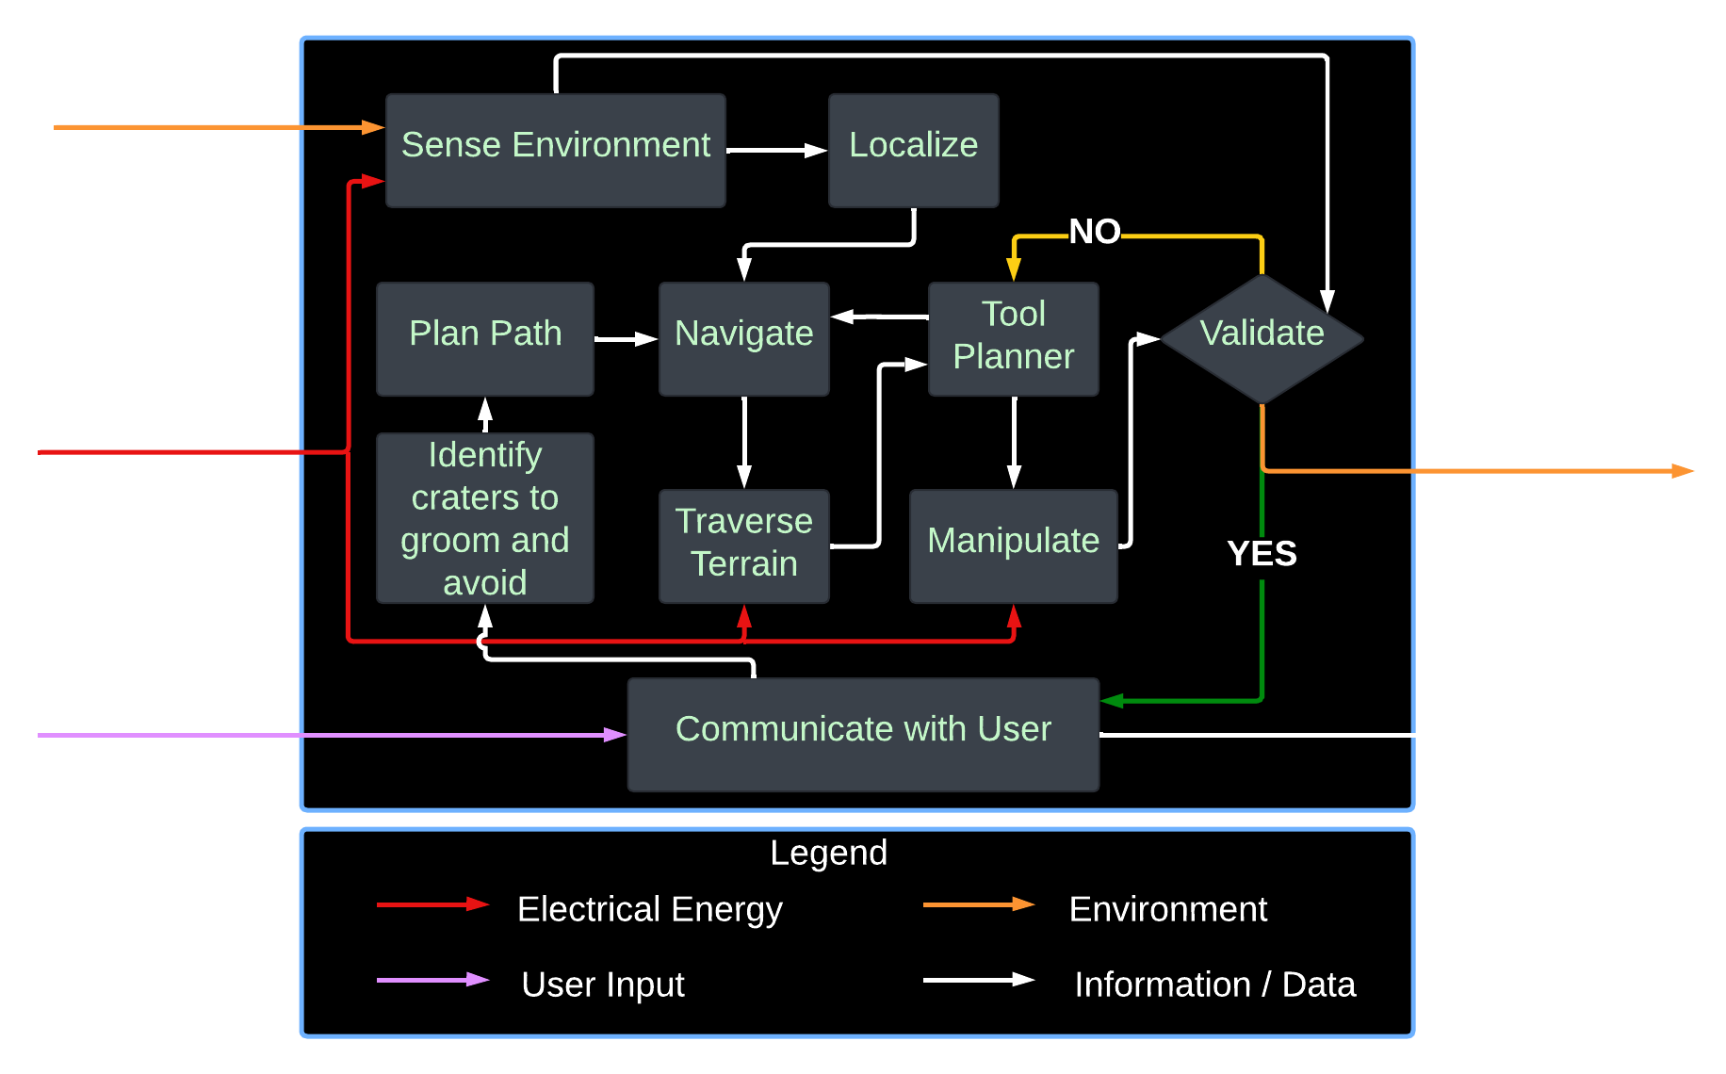
Functional Architecture

Slide 13
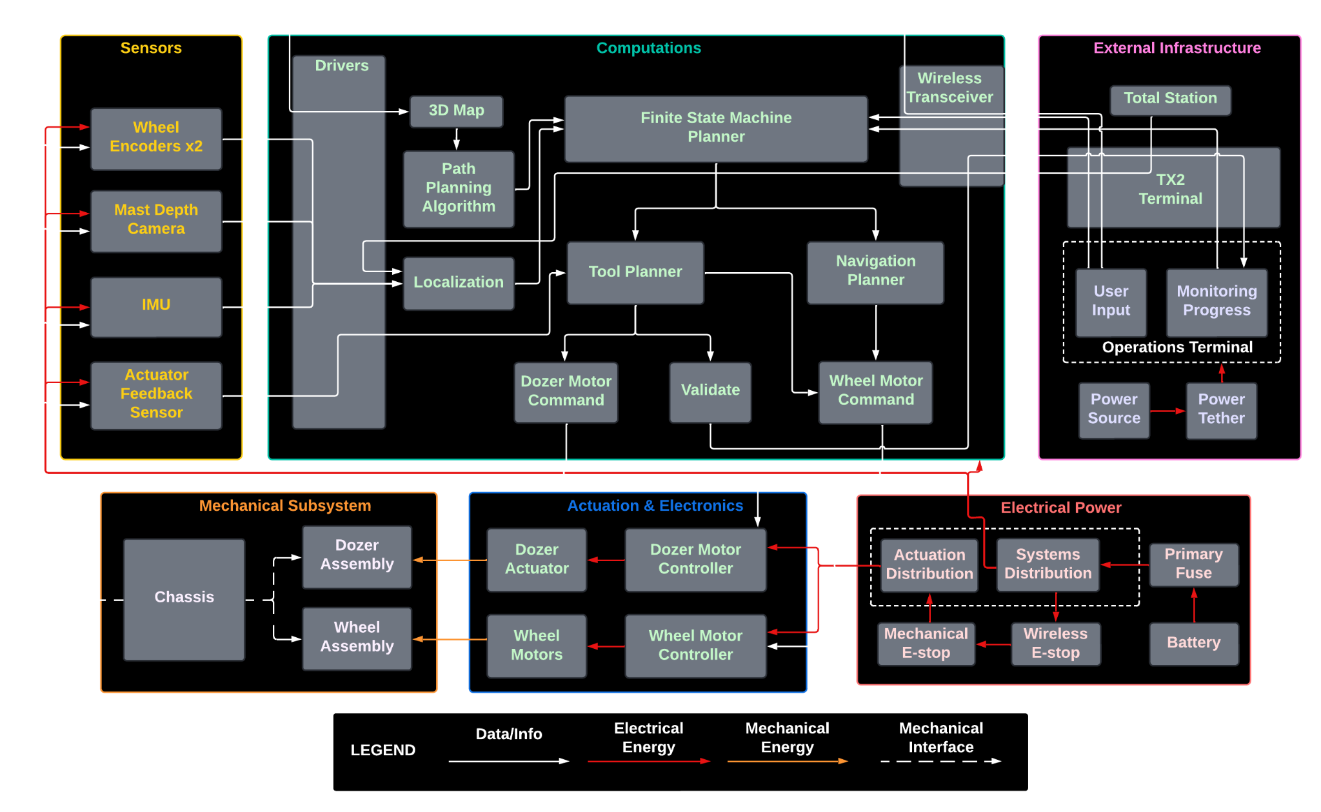
Cyber-Physical Architecture

Slide 14
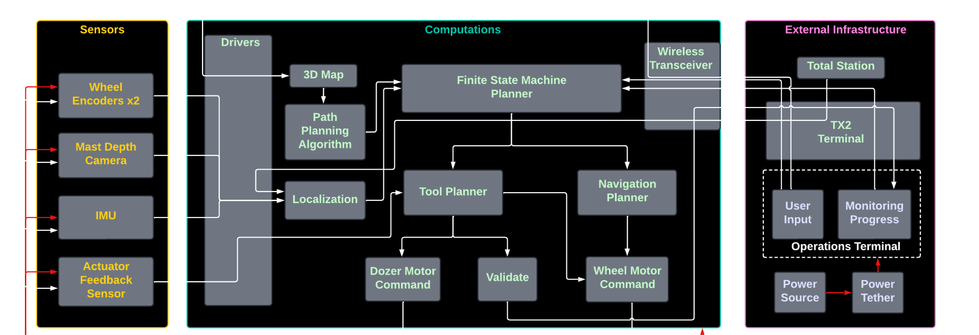
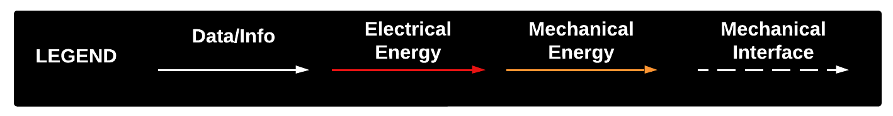
Cyber-Physical Architecture

Slide 15
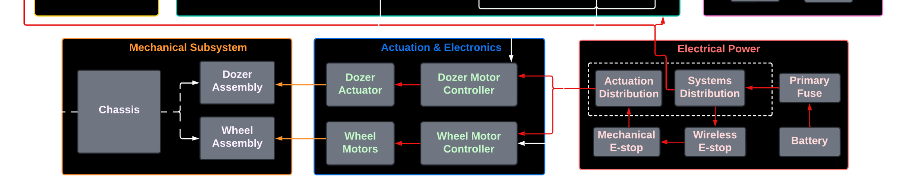
Cyber-Physical Architecture

Slide 16
Current System Status

Slide 17
Targeted Requirements in Spring
Requirement | Description | Status
M.P.1 | Will plan a path with cumulative deviation of <= 25% from chosen latitude’s length | Achieved
M.P.2 | Will follow planned path to a maximum deviation of 10% | Demonstrated
M.P.4 (Part 1) | Will avoid craters >= 0.5 metres | Demonstrated
M.P.5 | Will fill craters of up to 0.5 meters in diameter and 0.1m in depth | Demonstrated
M.N.1 | Weight - The rover must weigh under 50kg | Achieved
M.N.4 | Size - The rover should measure less than 1m in all dimensions | Missed
D.N.1 | Technological Extensibility - The system will be well documented and designed so that future teams can easily access and build on the work | Achieved
D.N.2 | Aesthetics - Rover must look presentable and lunar-ready | Demonstrated
Notes:
Demonstrated - achieved and shown in SVD
Achieved - done but not shown
Missed - not achieved

Slide 18
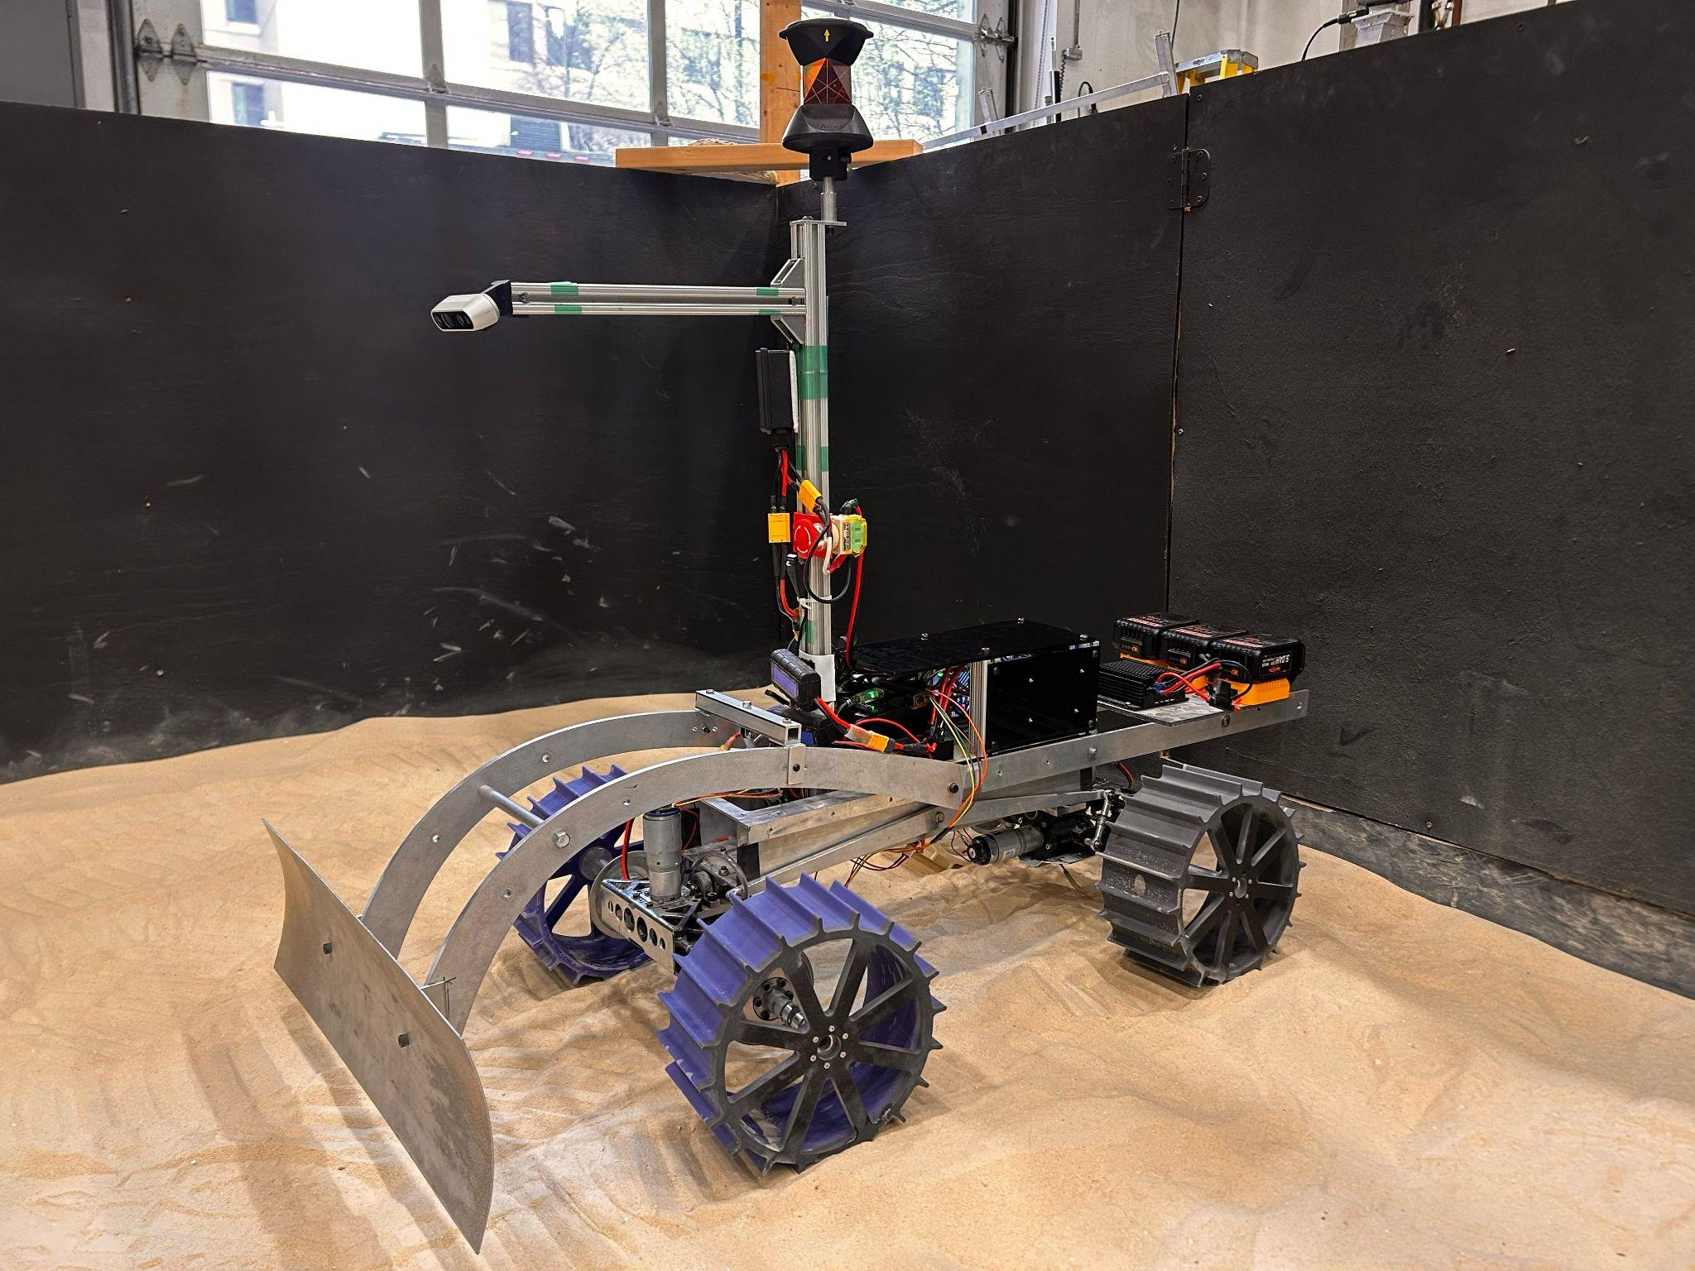
Overall System Depiction - Hardware
Leica Prism
20V Batteries x3
Intel Realsense
D235i
Jetson Xavier AGX
Electronics Box
Custom Wheel Design
Custom Dozer Blade

Slide 19
Overall System Depiction - Software
Navigation Planner
N
Goal Status Manipulation Status
Goal Waypoints Tool Trajectories
Rover Pose
Finite State Machine
L
T
Localization
Transport Planner
M
Global Map

Slide 20
Subsystem Completion Status
Subsystem | Completion % | Future Work
Sensors | 75% | Upgrade RealSense D235i to ZED 2i stereo camera
Computations | 60%
1. Jetson and Docker | 95% | Integrate ZED drivers
2. Localization Unit | 85% | Address frame shifts caused by battery replacements
3. Transport Planner Unit | 60% | Implement unit
4. Navigation Planner Unit | 90% | Tune navigation stack
5. FSM Planner Unit | 95% | Integrate validation unit into FSM
6. Validation Unit | 10% | Implement unit
External Infrastructure | 100% | None
Mechanical | 90%
1. Dozer Assembly | 90% | Refinement of dozer
2. Wheel Assembly | 90% | Wheel design iterations, final manufacturing
Actuation | 80% | Linear actuator upgrade/tuning, torque sensing
Electrical Power | 90% | Change battery placement

Slide 21
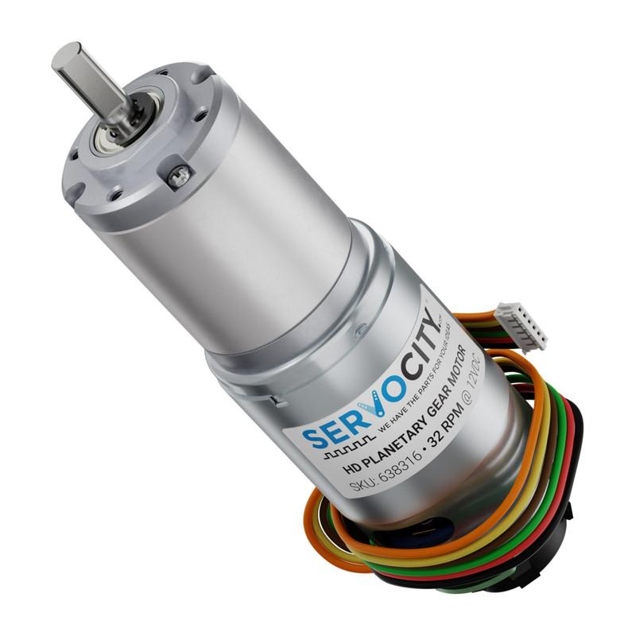
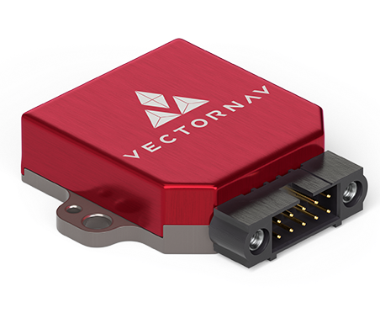
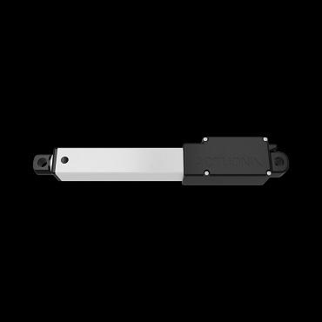
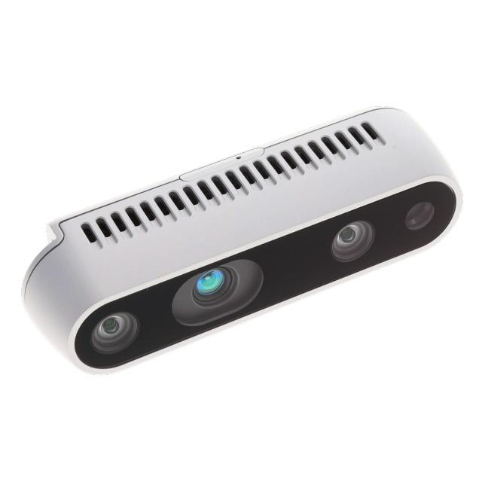
Description: Sensors Subsystem
Description: All sensors used on the rover for computations.
Requirements:
Wheel Encoders (x4)
Mast Depth Camera (RealSense D435i)
IMU (VectorNav)
Actuator Feedback Sensor
Expected Functionality: The sensor data is published to various ROS topics and can be used inside the Docker container to perform computations.

Slide 22
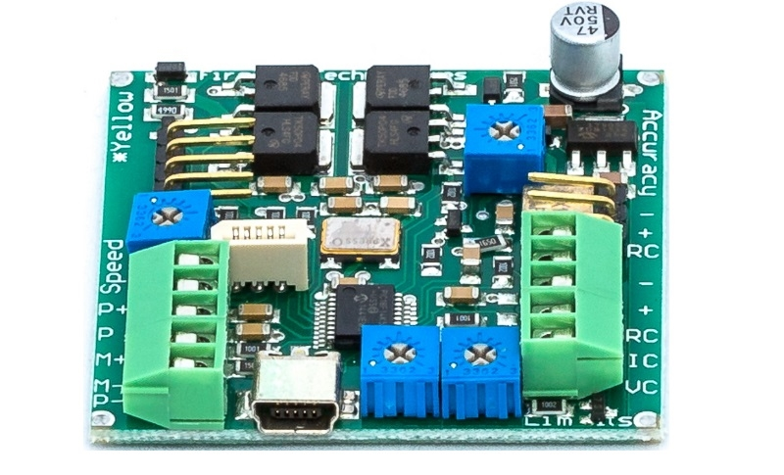
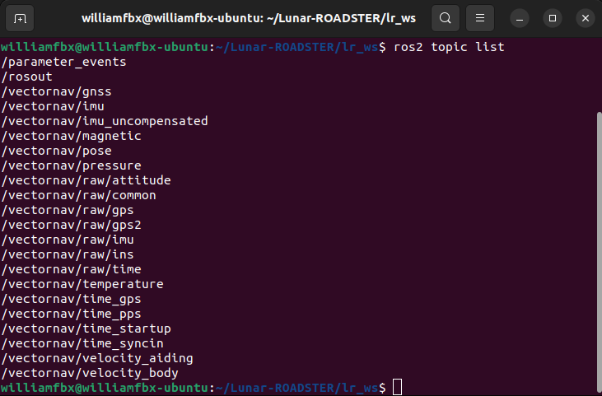
Status: Sensors Subsystem
Implementation:
IMU implemented using VectorNav ROS package
Wheel Encoder parsed using micro-ROS
Purchased actuator has a feedback potentiometer
Obtained RealSense point cloud feed using RealSense ROS wrappers
Challenges:
Difficulty integrating ZED SDK with docker container due to CUDA compatibility issues
Reverted back to using RealSense, which did not require CUDA
IMU firmware drivers were outdated
Status: 75% Complete
IMU, wheel encoder, and linear actuator finalized. Upgrade RealSense to ZED 2i in Fall semester

Slide 23
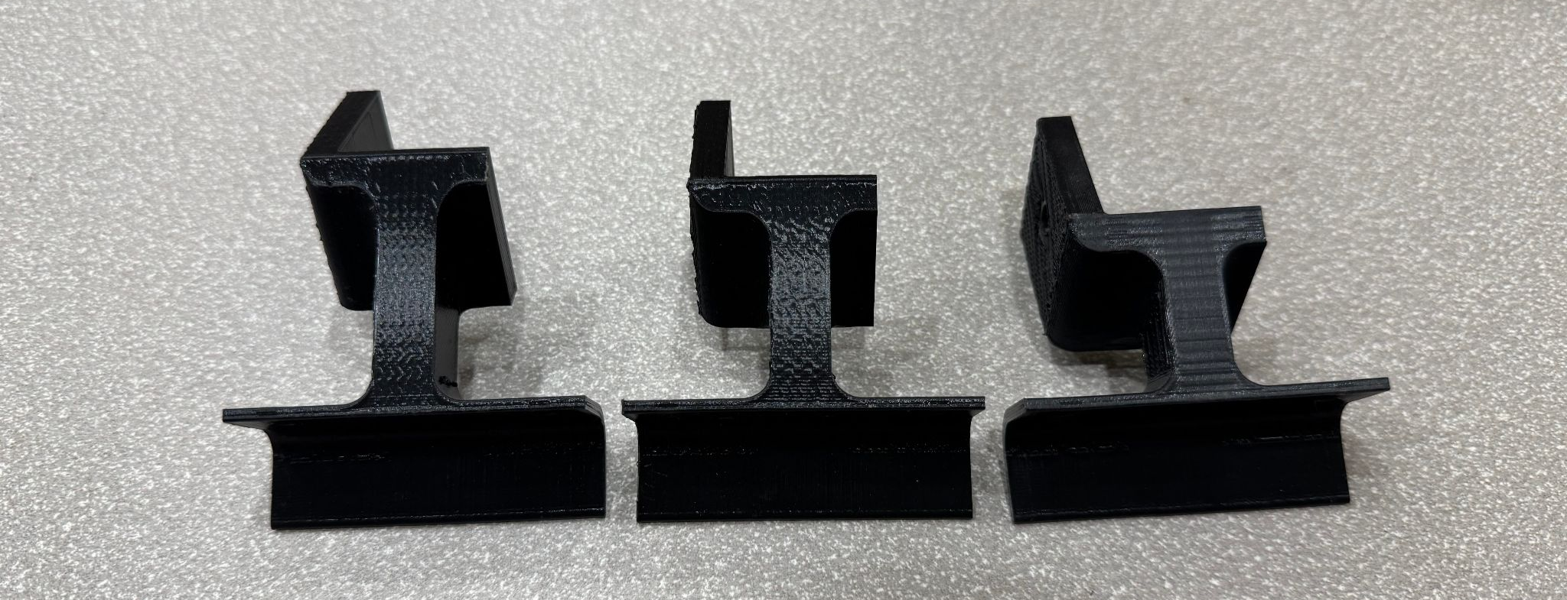
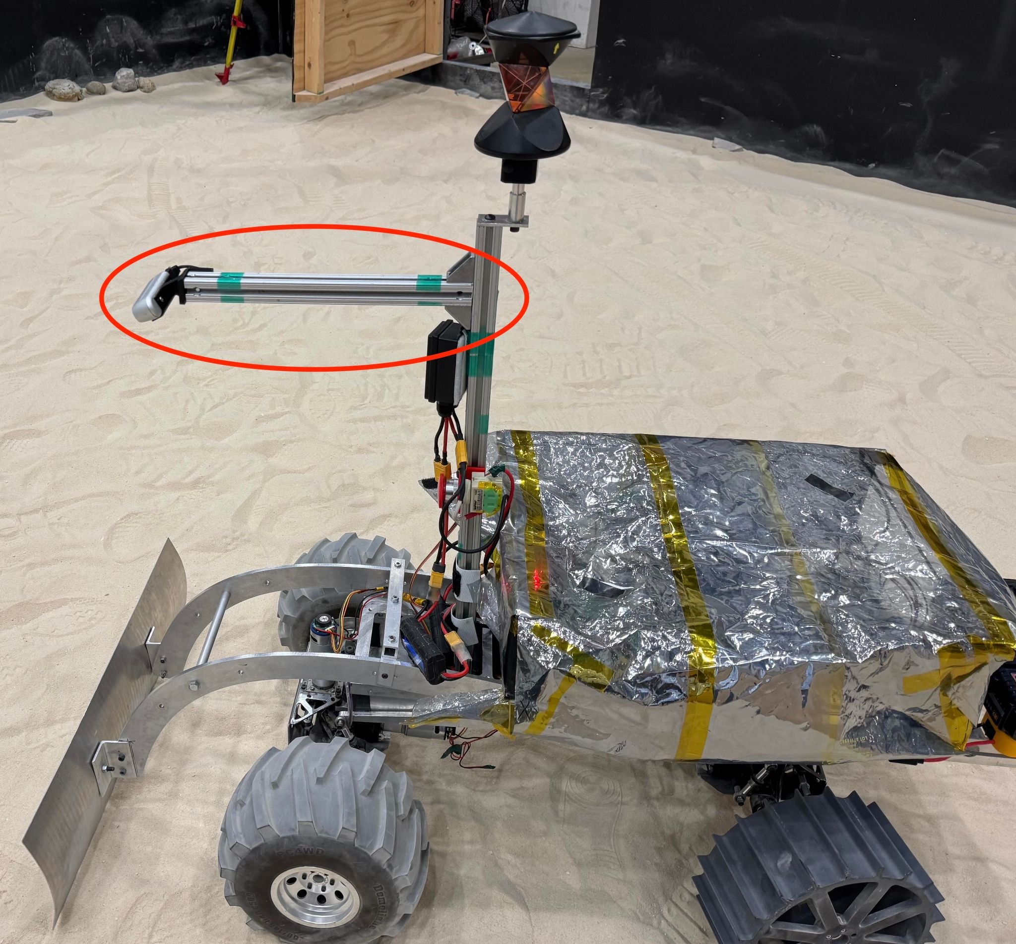
Evaluation: Sensors Subsystem
Modelling:
CAD designed and 3D printed mast depth camera mounts of 30, 40, 45, and 50 degree angles relative to mast
Analysis:
50 degree angled camera mount gives the best view of craters
However, if tool height is above 15%, occlusion occurs
Point cloud obtained from RealSense is not as dense as ZED 2i
Testing:
T10: Optimal Mast Depth Camera Placement Test
T14: Maintenance, Reliability and Quality Assurance Test

Slide 24
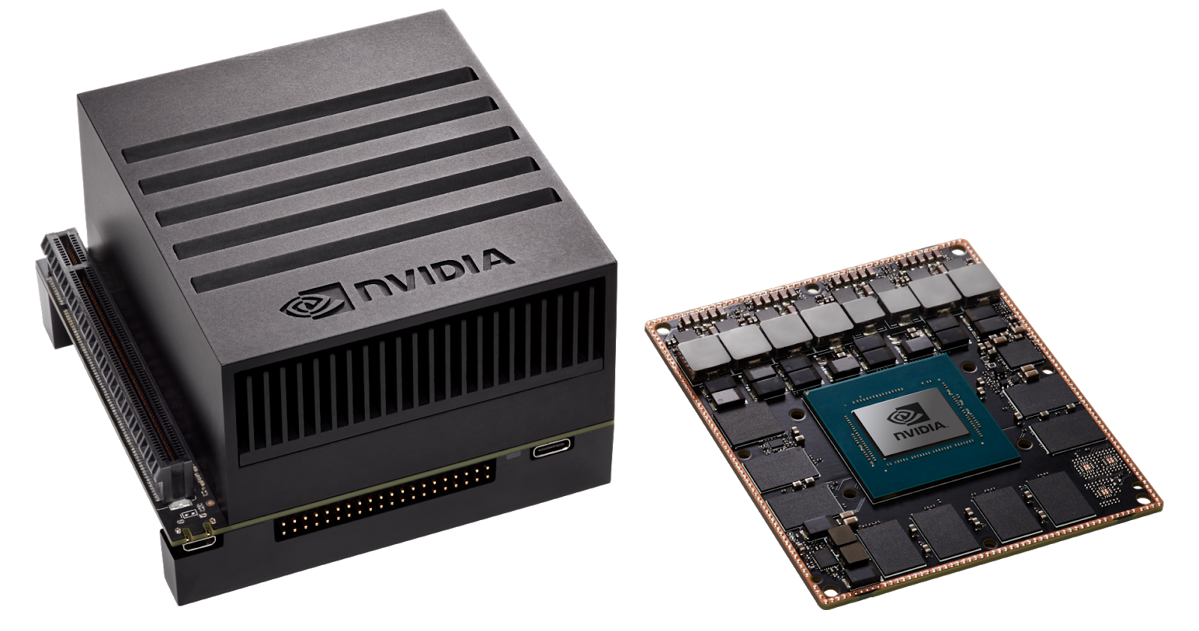
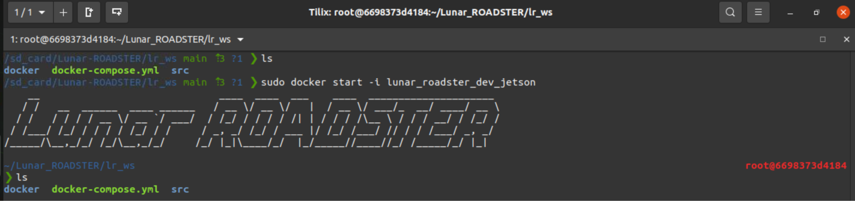
Description: Computations Subsystem
Jetson and Docker Unit
Description: Set up the Jetson AGX Xavier with Docker to host and run all critical system packages
Requirements:
NVIDIA Jetson AGX Xavier
LAN Router
Team laptop (operations terminal)
Expected Functionality:
Acts as primary on-board compute
Runs ROS2 Humble
Runs micro-ROS
Hosts and manages all necessary packages and device drivers inside Docker containers

Slide 25
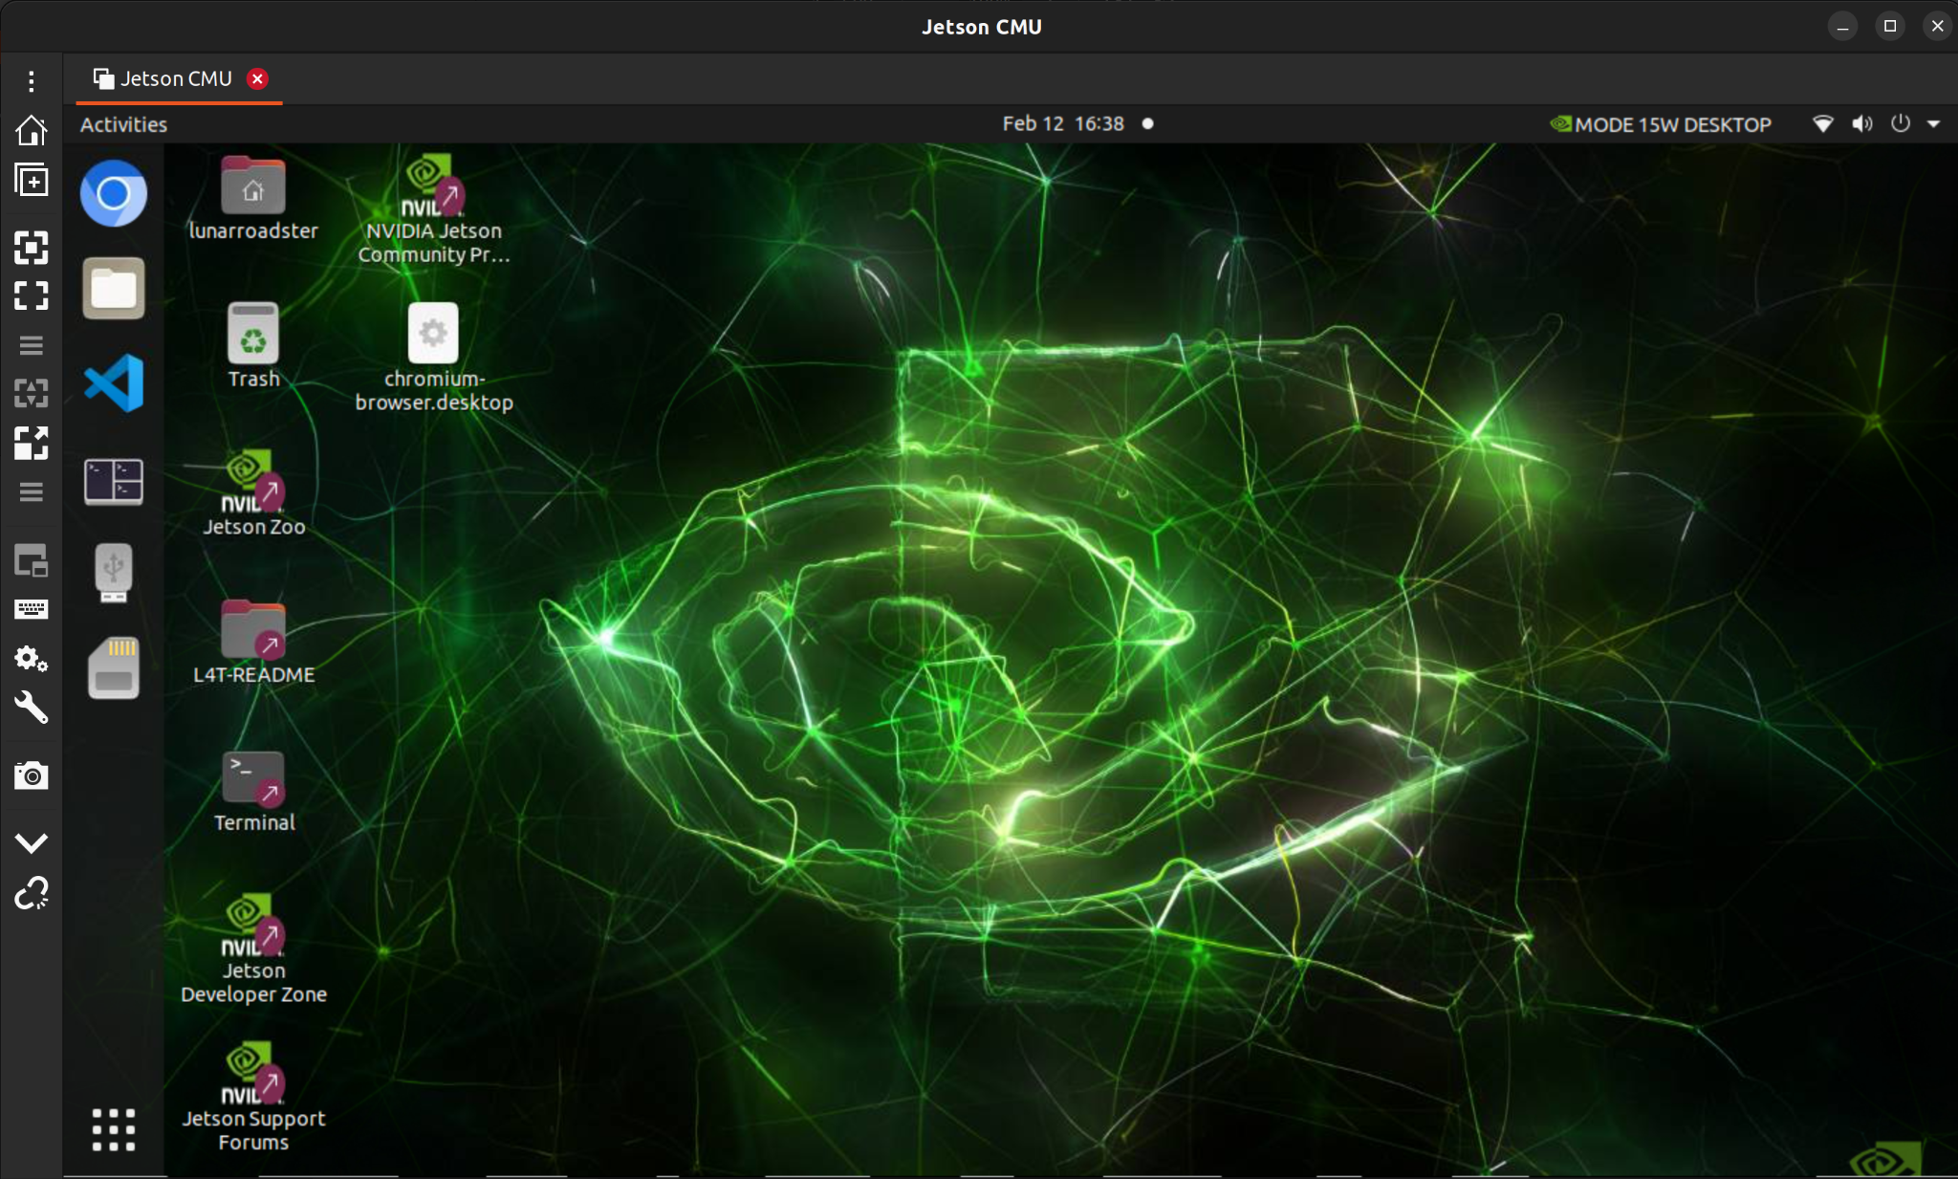
Status: Computations Subsystem
Jetson and Docker Unit
Implementation:
Connect Jetson to rover’s power system
Assigned static IP on the LAN to enable SSH-based remote access from operations terminal
Start docker container and initialize all core services and packages
Challenges:
Setup of a VNC server for remote GUI access
Status: 95% Complete
Need to integrate ZED SDK drivers

Slide 26
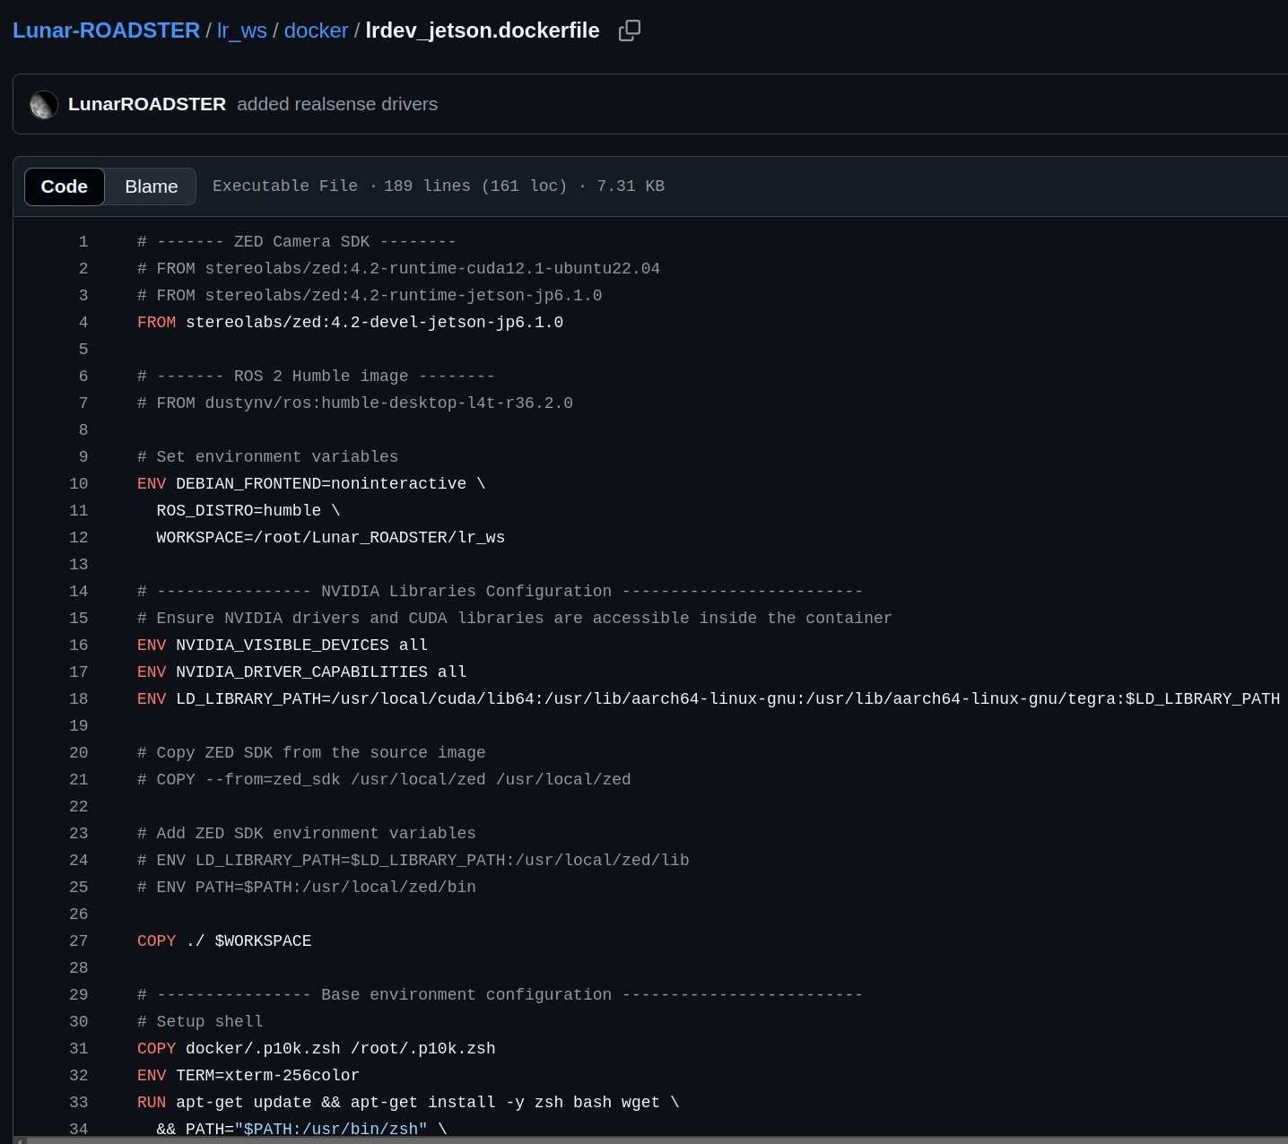
Evaluation: Computations Subsystem
Jetson and Docker Unit
Modelling:
Created custom Dockerfile that installs all required system packages
Analysis:
Verified that all required nodes and drivers start successfully inside the container
Testing:
T03: Depth Camera Connectivity Test
Upgrade to higher performance Jetson – Fall Goal

Slide 27
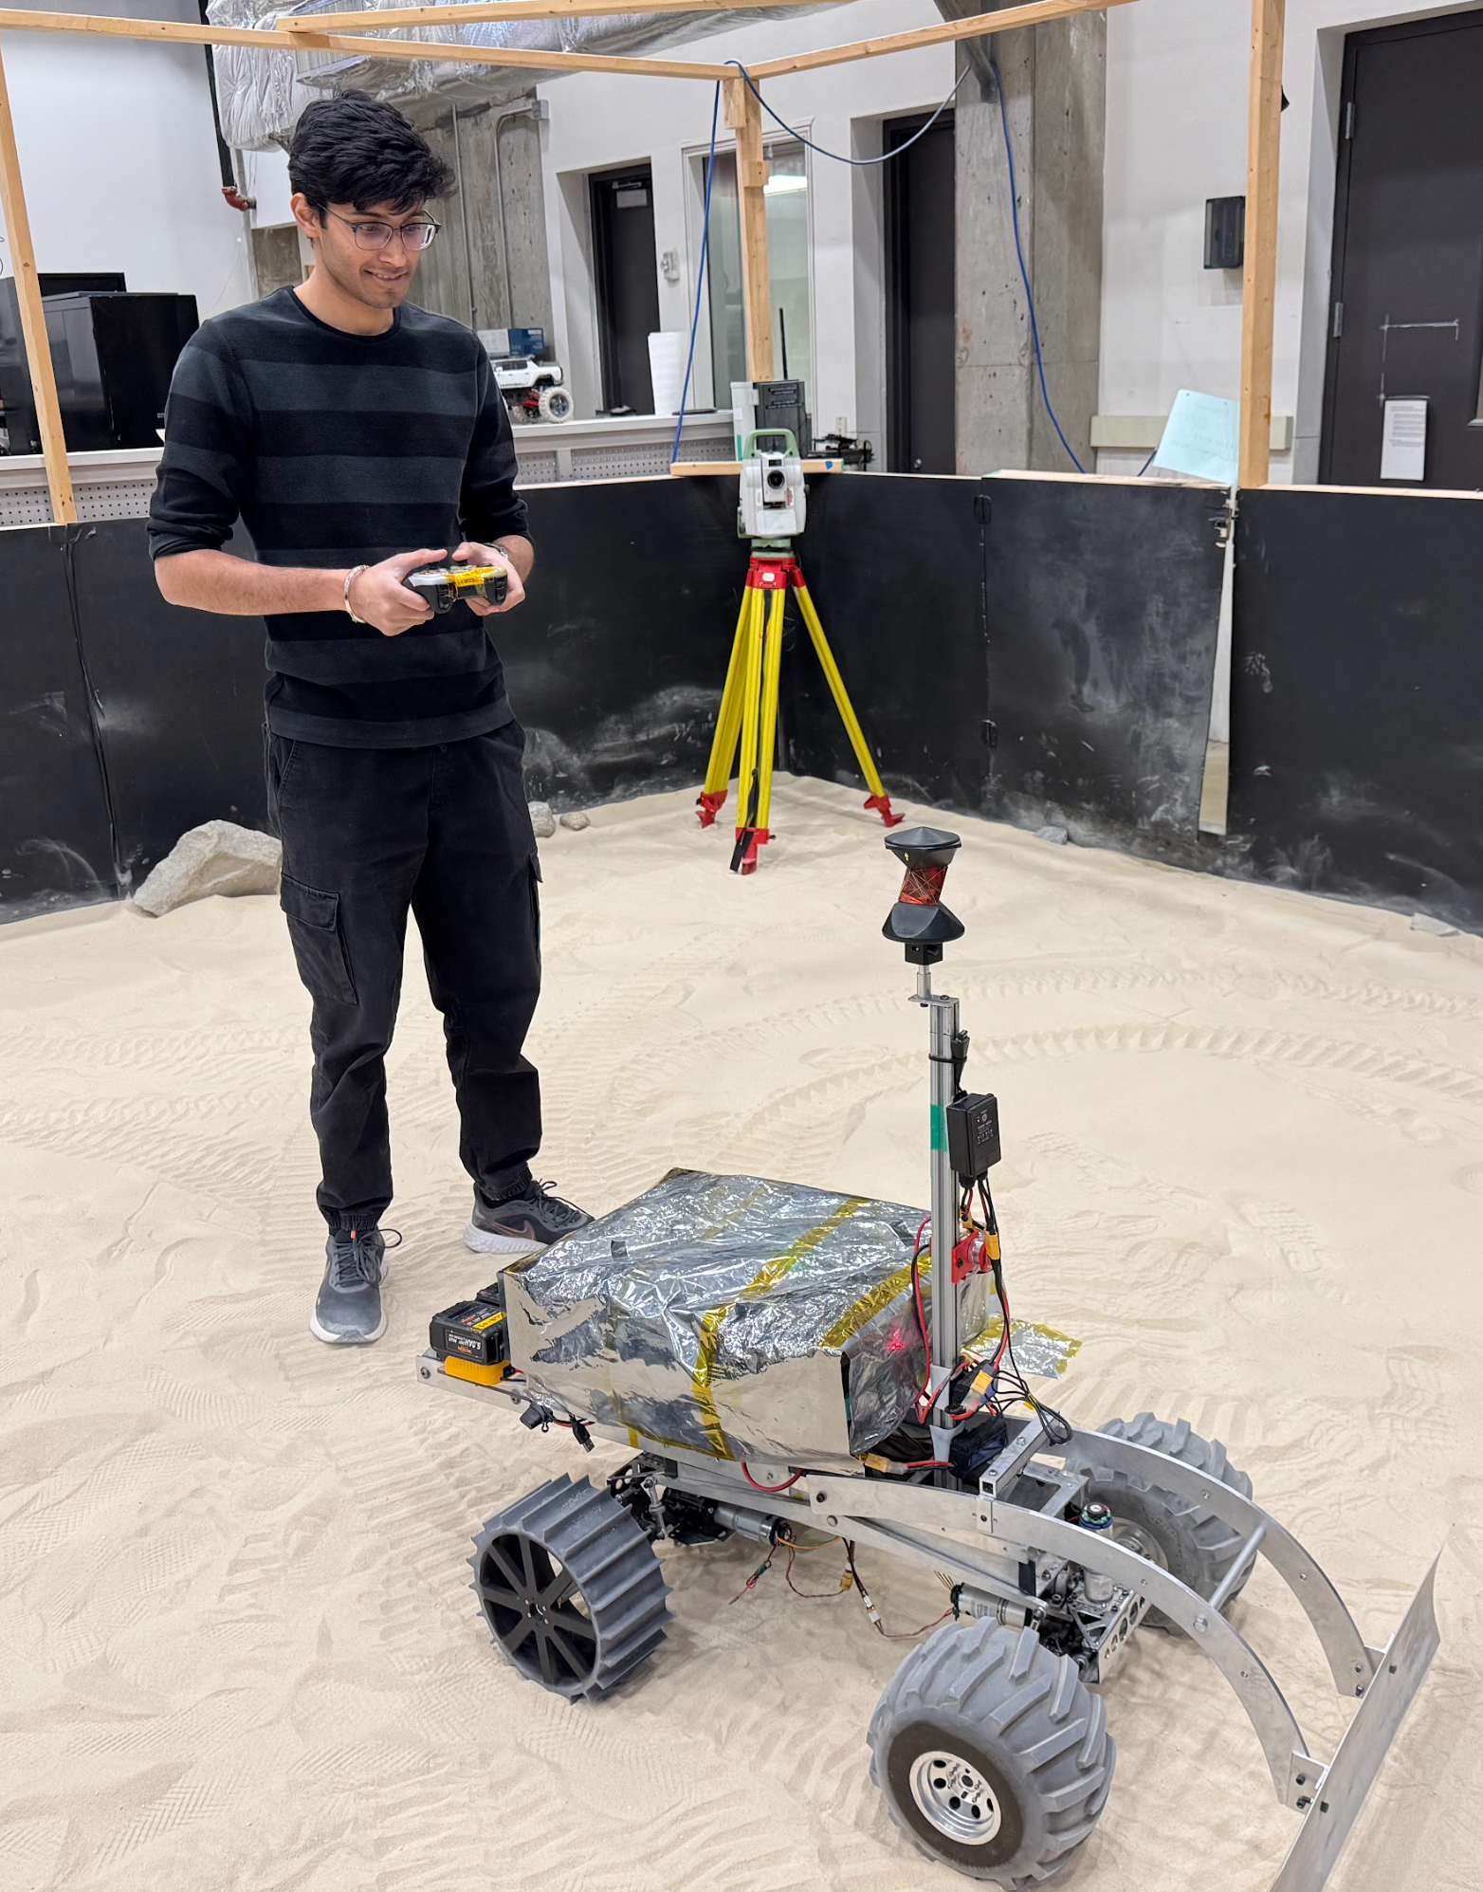
Description: Computations Subsystem
Localization Unit
Description: Localize the rover in the Moon Yard
Requirements:
Leica TS16 Total Station
NVIDIA TX2 Relay Chip + LAN
VectorNav IMU
Wheel Encoders
Expected Functionality: Accurately localize rover pose inside the Moon Yard, to be used further for navigation

Slide 28
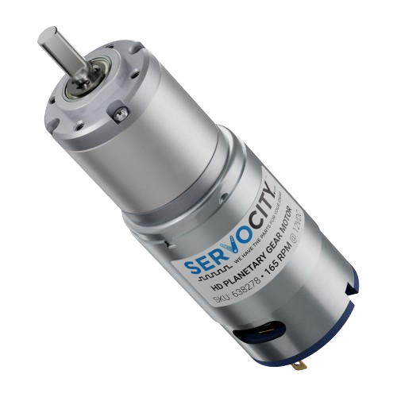
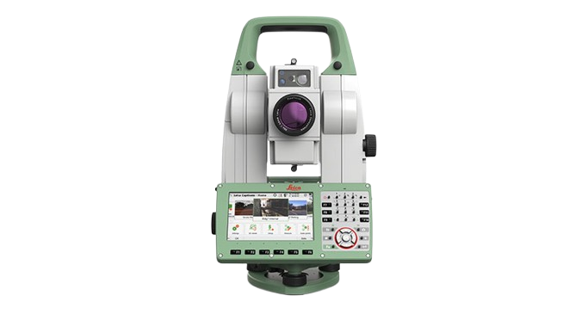
Status: Computations Subsystem
Localization Unit
Implementation:
On-board IMU and encoders used for local localization
Total station data fused with IMU and encoders for global localization
EKF running on Jetson using robot_localization package, now tuned to prevent odometry drift
Yaw calibration to ensure IMU data is w.r.t map frame
Challenges:
Incorrect Jetson Docker network permissions blocked two-way communication
Minor offset introduced when total station battery is replaced, causing frame inconsistencies
Status: 85% Complete
Address frame shifts caused by total station battery replacements
Leica TS16 Total Station
VectorNav VN-100 IMU
Wheel Encoders
Global Localization
Local Localization
Extended Kalman Filter
Rover Pose

Slide 29
Evaluation: Computations Subsystem
Localization Unit
Modelling:
Configured and tuned EKF to fuse sensor inputs
Set up frame transforms to ensure all sensor data aligns properly at base_link frame
Performed yaw calibration to ensure consistent orientation data from IMU
Analysis:
Analyzed pose stability and drift over time during testing
Analyzed sensor noise and measurement delays, tuning EKF parameters to minimize odometry drift
Assessed effect of total station resections and battery swaps on accuracy
Testing:
T09: Rover can localize itself accurately
T15: Spring Validation Demo Test

Slide 30
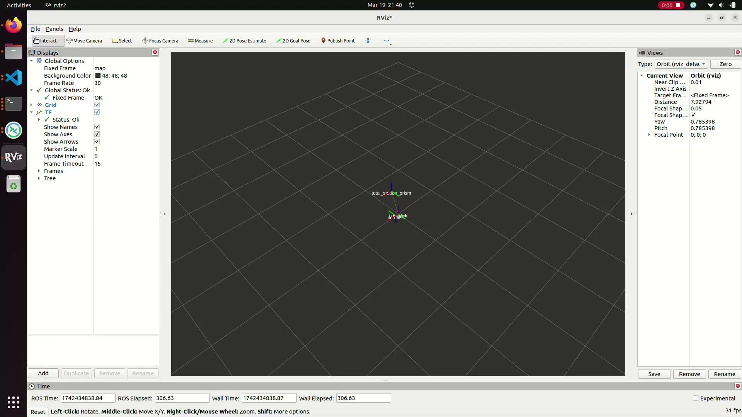
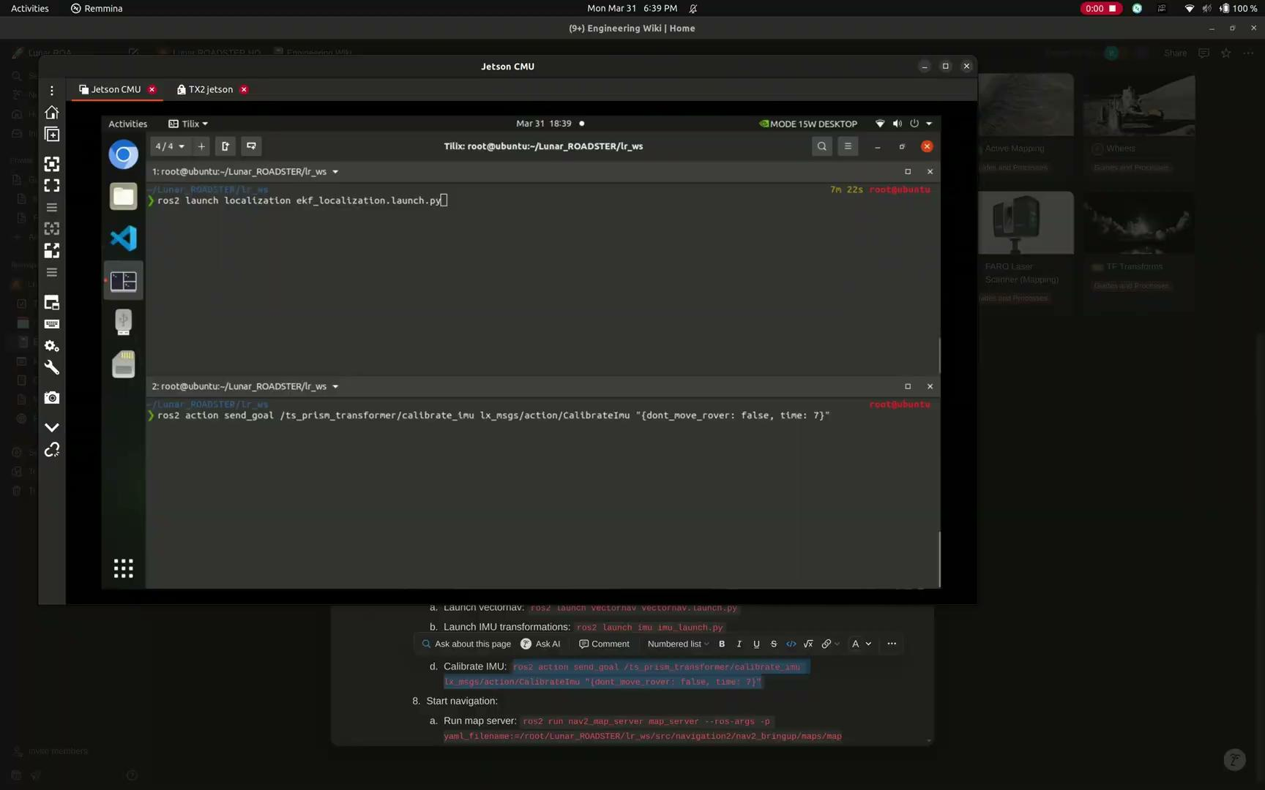
Evaluation: Computations Subsystem
Localization Unit
Localization drift issue
Drift corrected + Yaw calibrated
New localization method using SkyCam to be implemented to remove total station dependency – Fall Goal

Slide 31
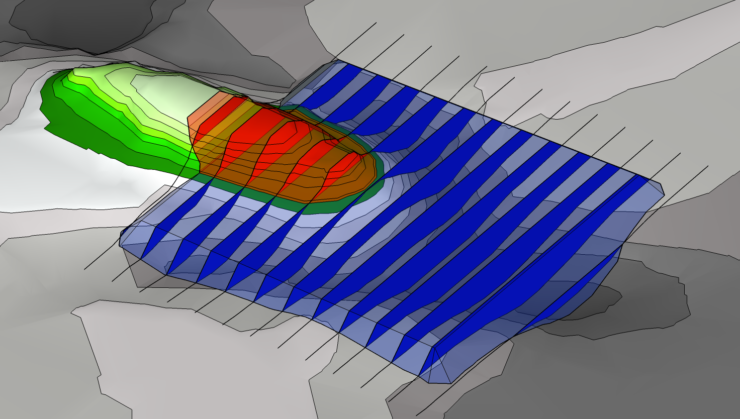
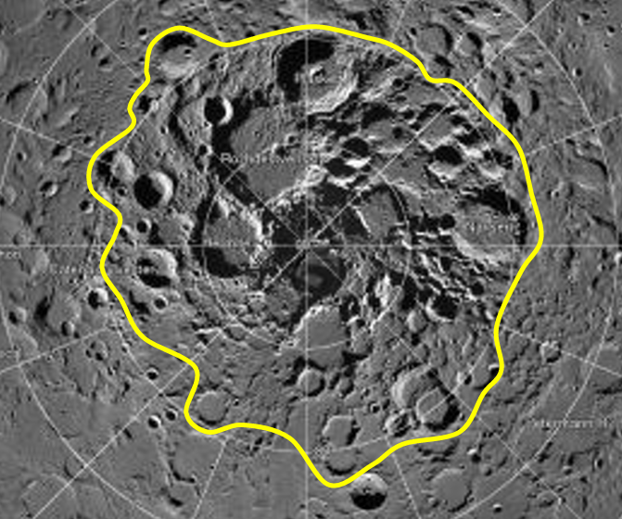
Description: Transport Planner Unit
Description: Subsystem that plans sand manipulation by using the tool and drive train.
Requirements
Jetson Xavier AGX
Dozer Assembly
Drivetrain (with Wheel Assembly)
Global Map
Expected Functionality
Plans a control input for the tool
Plans a trajectory for the rover for manipulation
Outputs waypoints and tool trajectories to the navigation planner

Slide 32
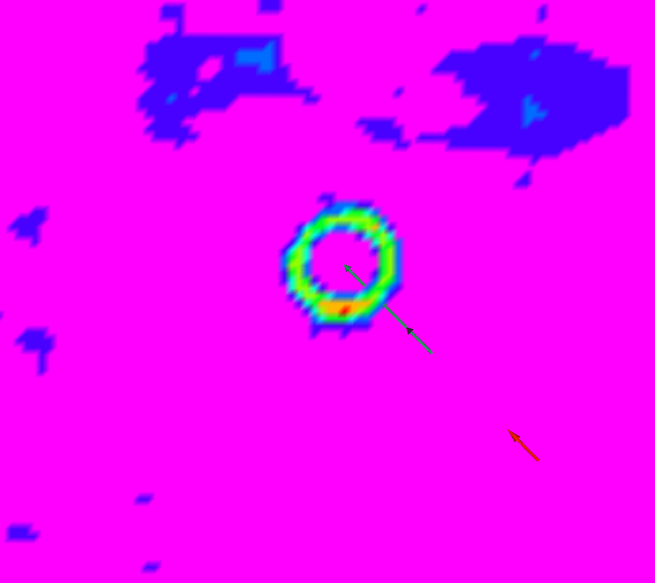
Status: Transport Planner Unit
Implementation:
Global Map is used to identify source and sink nodes.
Transport Assignments are generated between sources and sinks, based on minimizing a cost function
ROADSTER Waypoints are obtained from the filtered assignments to generate paths and tool trajectories.
Methodology needs to be adapted for multiple craters
Challenges:
Processing a dense point cloud
Modelling tool size within the subsystem for optimal plans
Status: 60% complete
Planned Goals
Current Goal

Slide 33
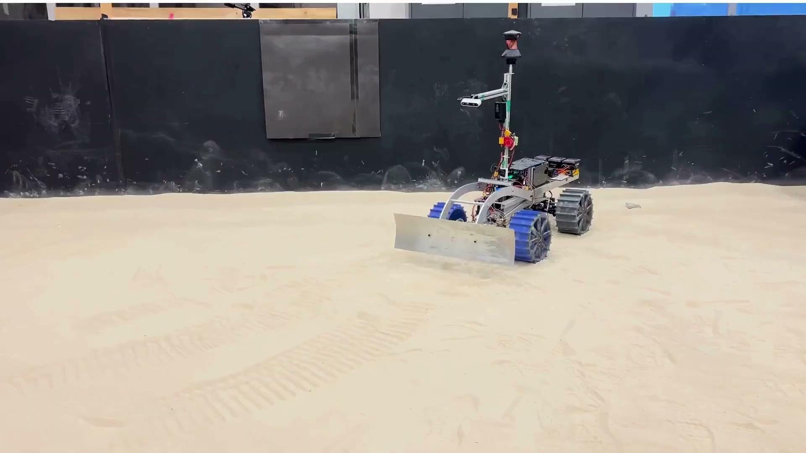
Evaluation: Transport Planner Unit
4x
Notes:
Able to find source and sink nodes well and plan transport for one crater
Say what the poses are as they show up

Slide 34
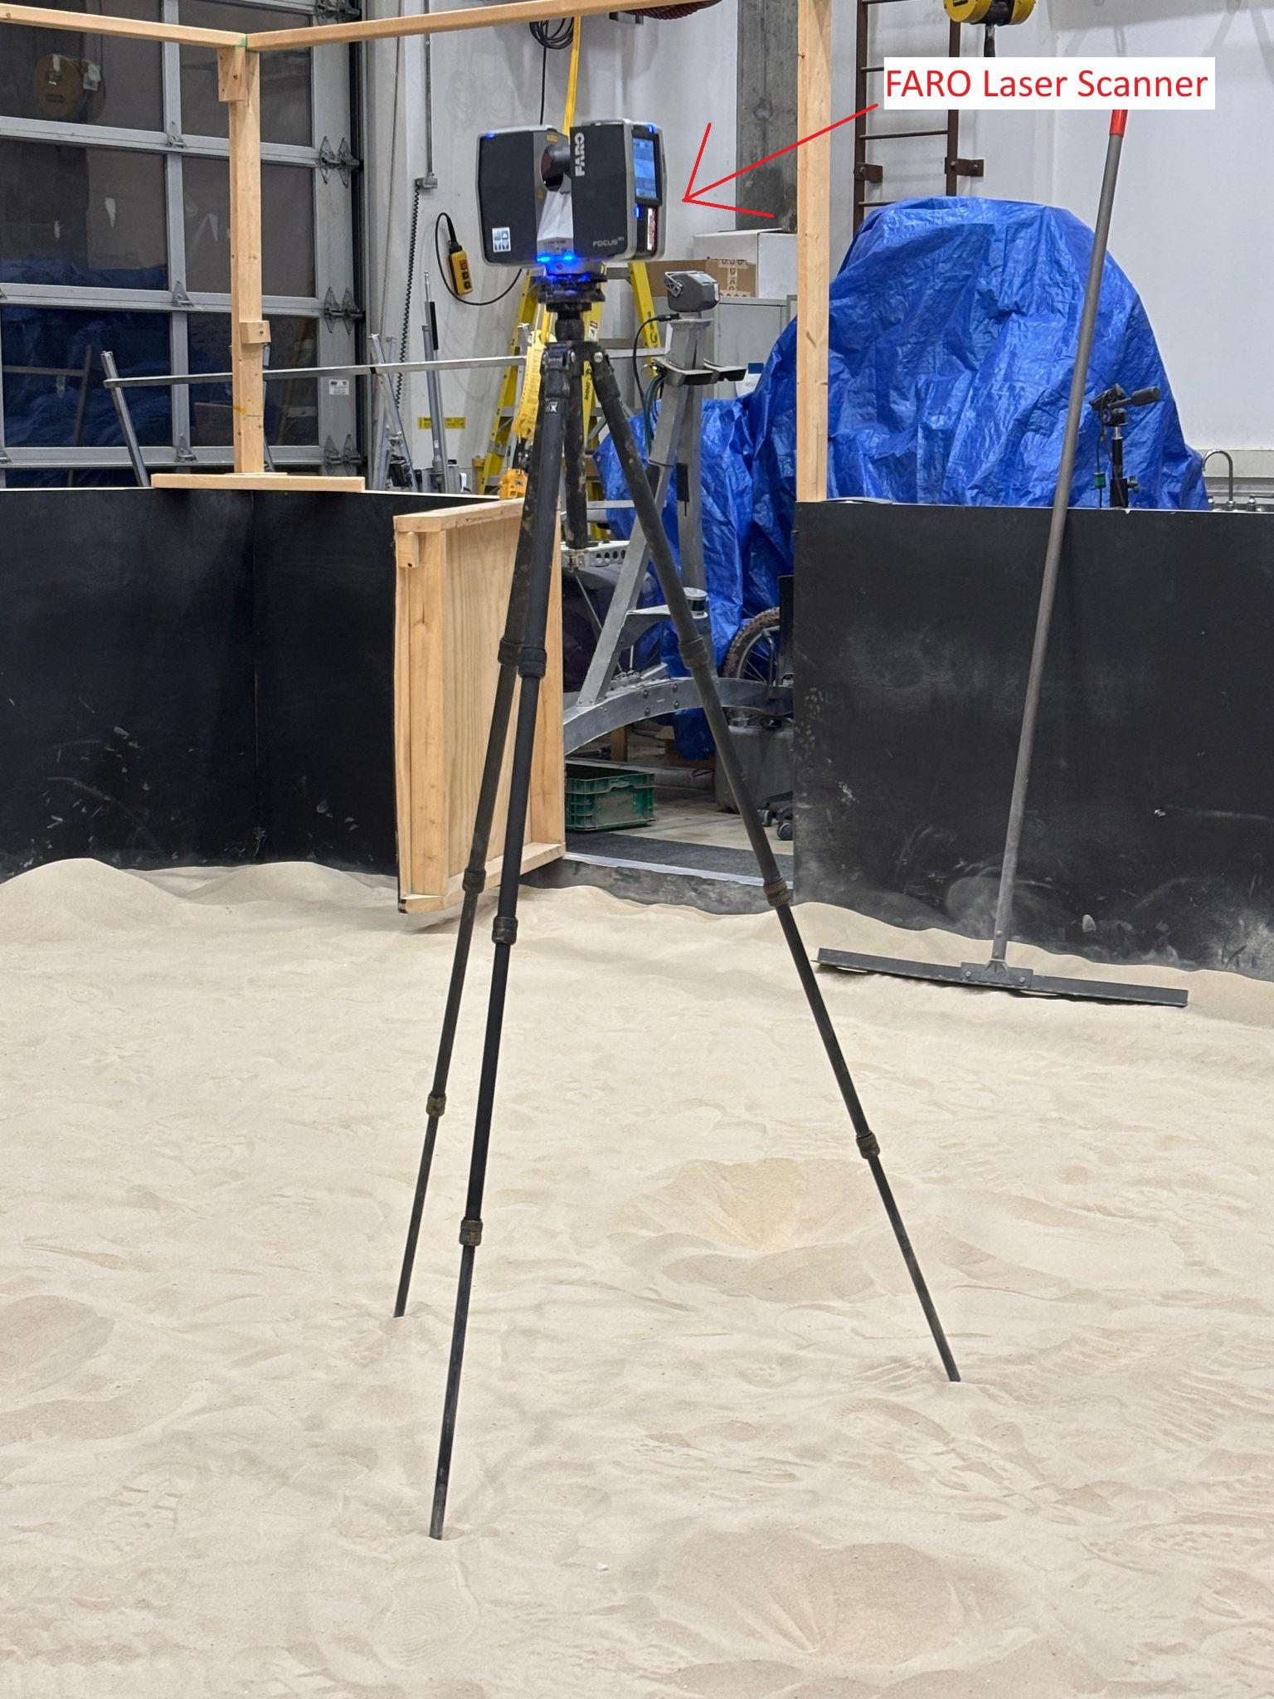
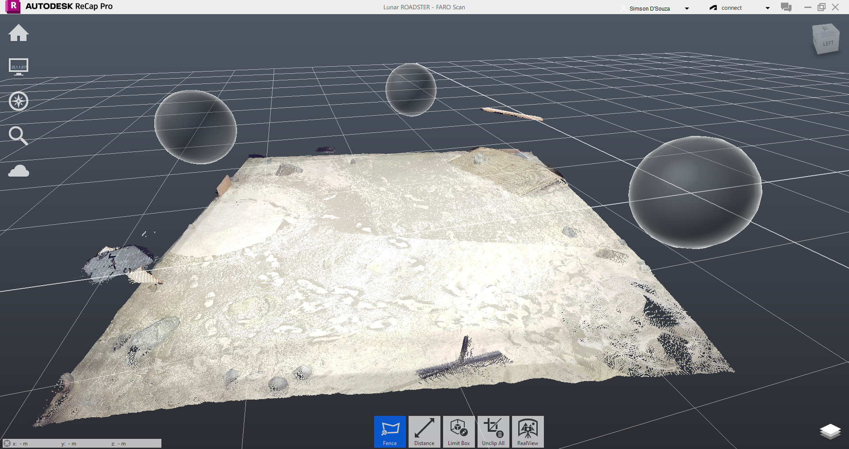
Description: Computations Subsystem
Navigation Planner Unit
Description: Identify gradable craters, obtain coordinates, and navigate the rover to their locations
Requirements:
FARO Laser Scanner
NVIDIA Jetson AGX Xavier
Team laptop (operations terminal)
Expected Functionality:
Accurately detect and classify gradable craters
Ensure no gradable crater is overlooked
Compute an optimal navigation path while avoiding obstacles (non-gradable craters and rocks)
Navigate and reach the goal location correctly

Slide 35
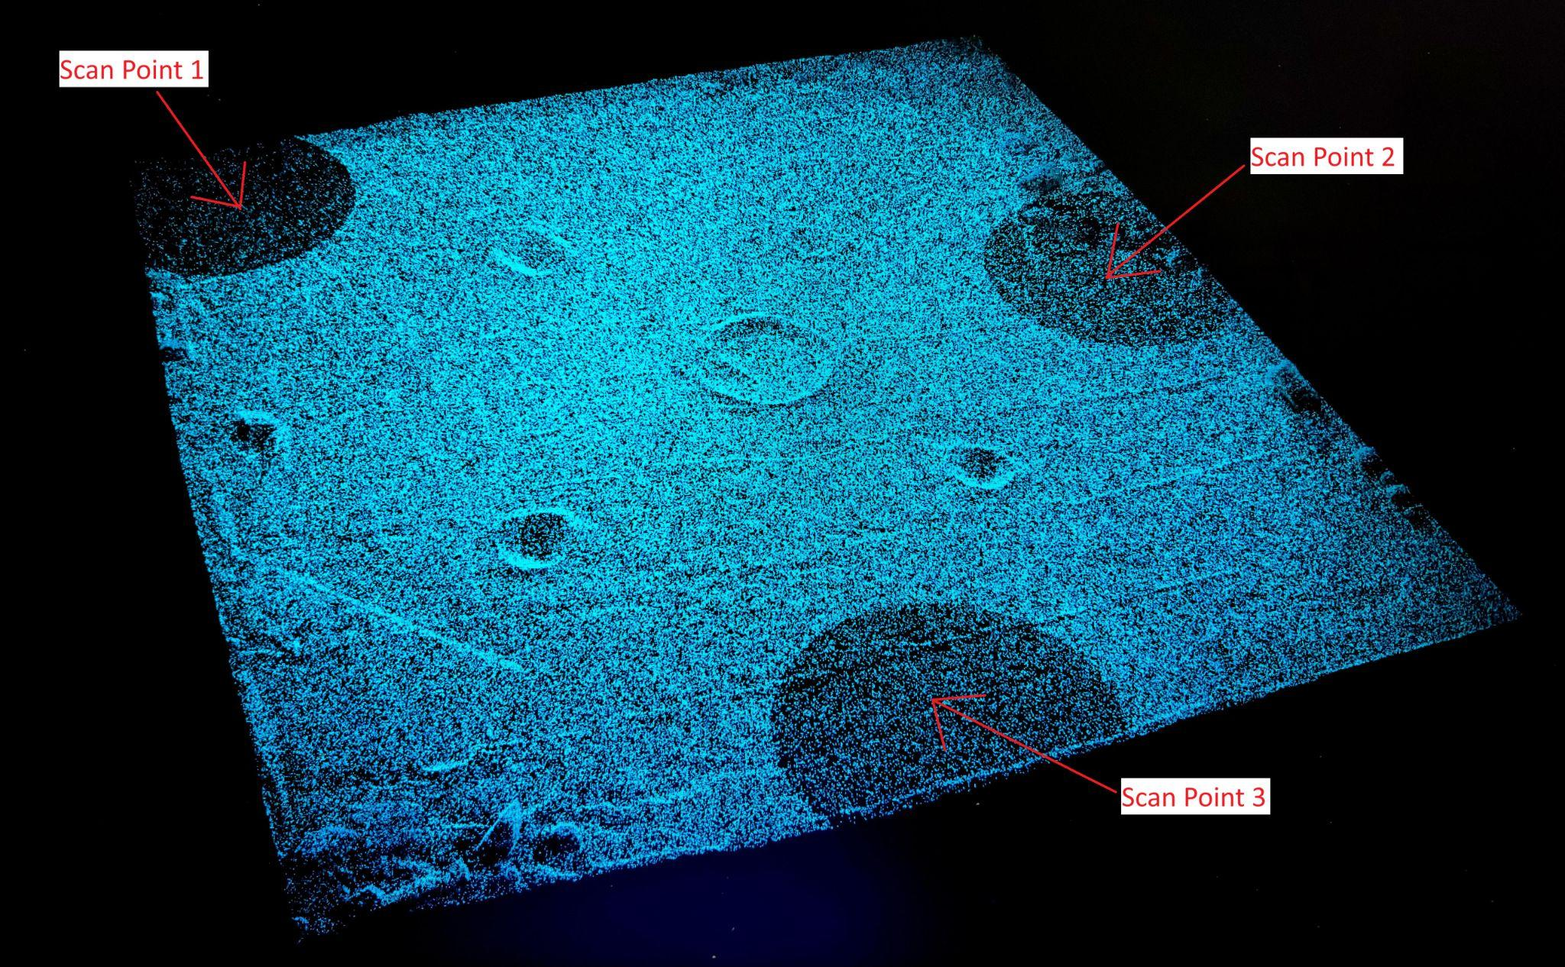
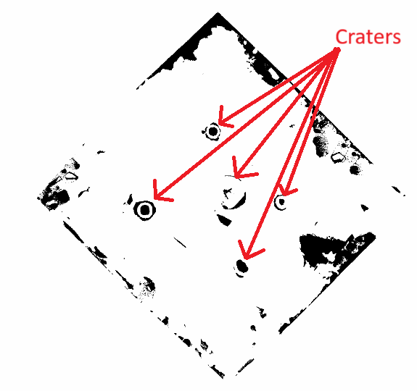
Status: Computations Subsystem
Navigation Planner Unit
Implementation:
Mapped the Moon Yard using the FARO Laser Scanner to generate a point cloud.
Converted the point cloud file into a ROS-compatible format.
Applied RANSAC for plane fitting and implemented thresholding to generate a 2D costmap for navigation.
Identified craters based on diameter and depth, extracting their coordinates.
Integrated navigation with tool planner to perform transport assignments
Challenges:
FARO output file (.fls) was incompatible with the PCL library and ROS.
Plane fitting for identifying gradable craters was challenging due to uneven terrain.
Accurately classifying gradable craters based on diameter and depth.
Fine-tune Nav2 parameters for optimal performance on our robot and ensure accurate robot localization
Status: 90% Complete (Tune Navigation Stack) - Fall Goal
Moon Yard Scan Visualization
Global Costmap

Slide 36
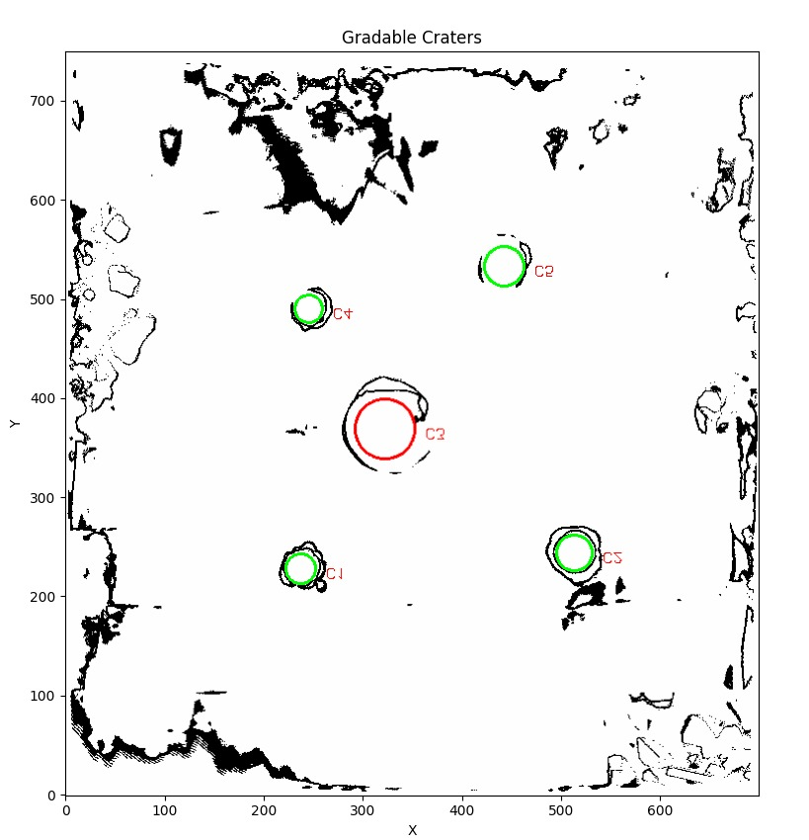
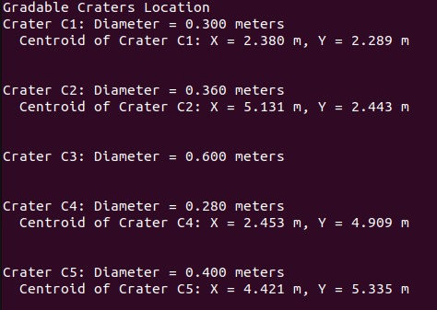
Evaluation: Computations Subsystem
Navigation Planner Unit
Gradable Craters
Modeling:
Generated dense point cloud maps by taking multiple FARO scans and updated the map origin for consistent localization and navigation frames
Tuned Nav2 parameters to suit Ackermann steering kinematics.
Used RViz extensively to visualize and debug transformations and paths
Analysis:
Evaluated planned paths for smoothness, obstacle avoidance, and feasibility
Analyzed factors affecting navigation: localization noise, data delay, computation load, and parameter tuning
Testing:
T08: Mapping the Moon Yard and visualize the point cloud data
T11: Navigate and reach the goal location correctly
T15: Spring Validation Demo Test
Identified Gradable Craters
Gradable Craters Location

Slide 37
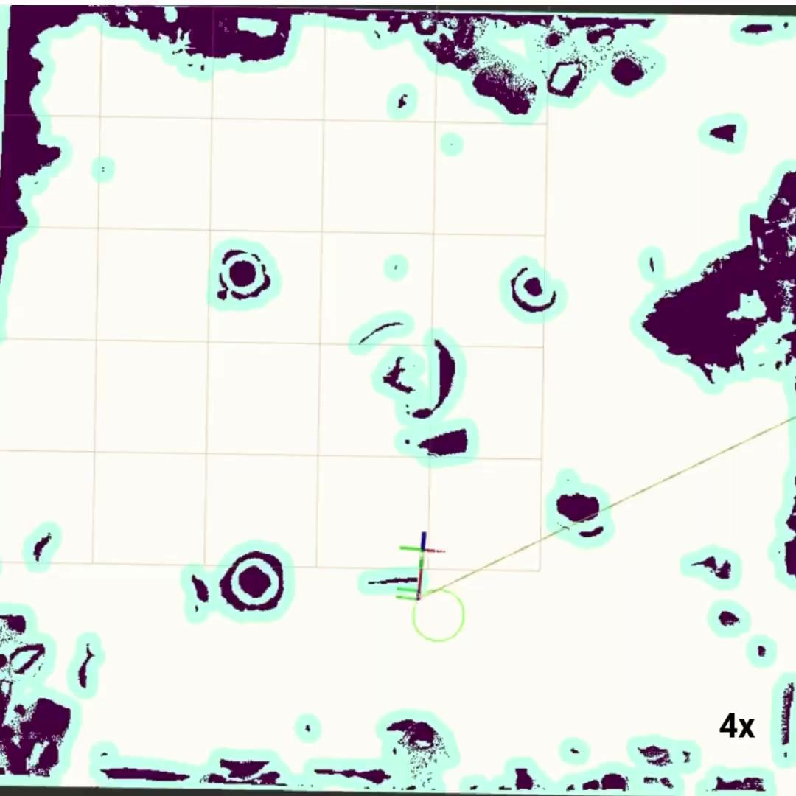
Evaluation: Computations Subsystem
Navigation Planner Unit

Slide 38
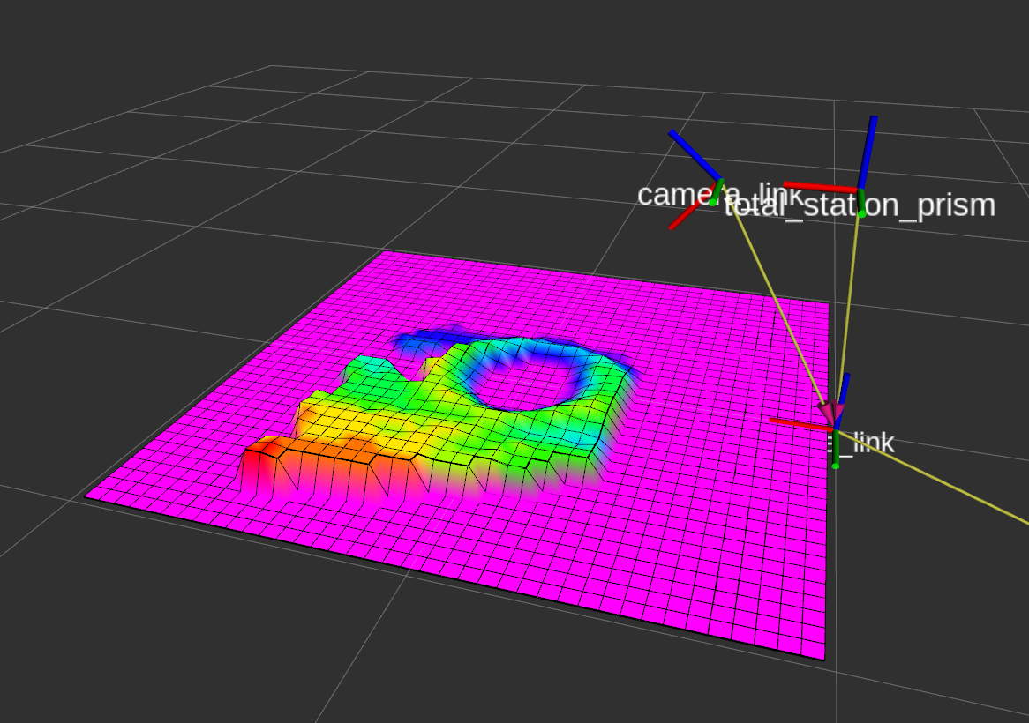
Description: Computations Subsystem
Validation Unit
Description: Validates if groomed crater satisfies maximum traversability requirement (M.P.6)
Requirements:
RealSense D235i or ZED 2i stereo camera
Camera driver packages
Jetson Xavier AGX
Expected Functionality:
Outputs trail RMSE elevation error and/or maximum traversal slope

Slide 39
Status: Computations Subsystem
Validation Unit
Implementation:
Preliminary implementation for SVD Encore by calculating RMSE relative to mean elevation
Will implement full unit in Fall semester using mast camera
Challenges:
Rover mast moves due to rover suspension. May cause errors in estimating the ground plane
Compute is not enough for RealSense point cloud feed at 30 FPS
Status: 10% Complete

Slide 40
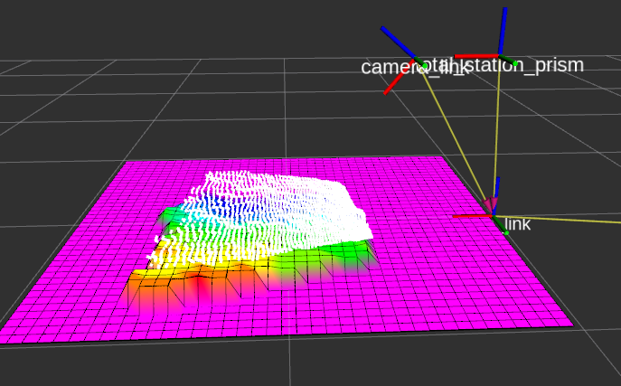
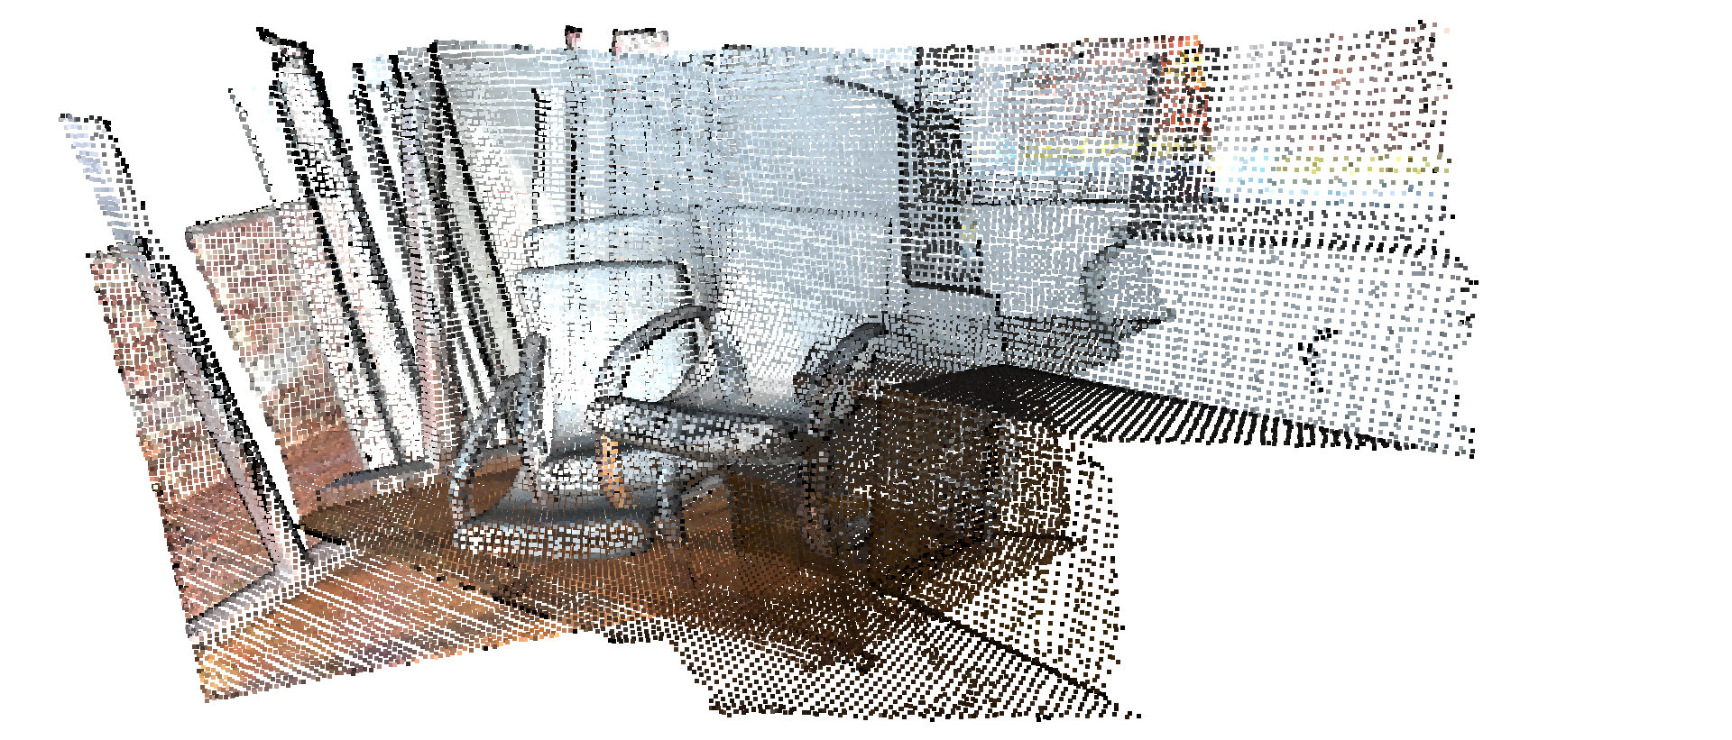
Evaluation: Computations Subsystem
Validation Unit
Modelling:
Calibrated camera {X, Y, Z, R, P, Y} so that flat ground has zero elevation and no rotation
Analysis:
Point cloud obtained from RealSense is not as dense as ZED 2i. May not be adequate for validation requirements
Testing:
Milestone deadline set for PR8

Slide 41
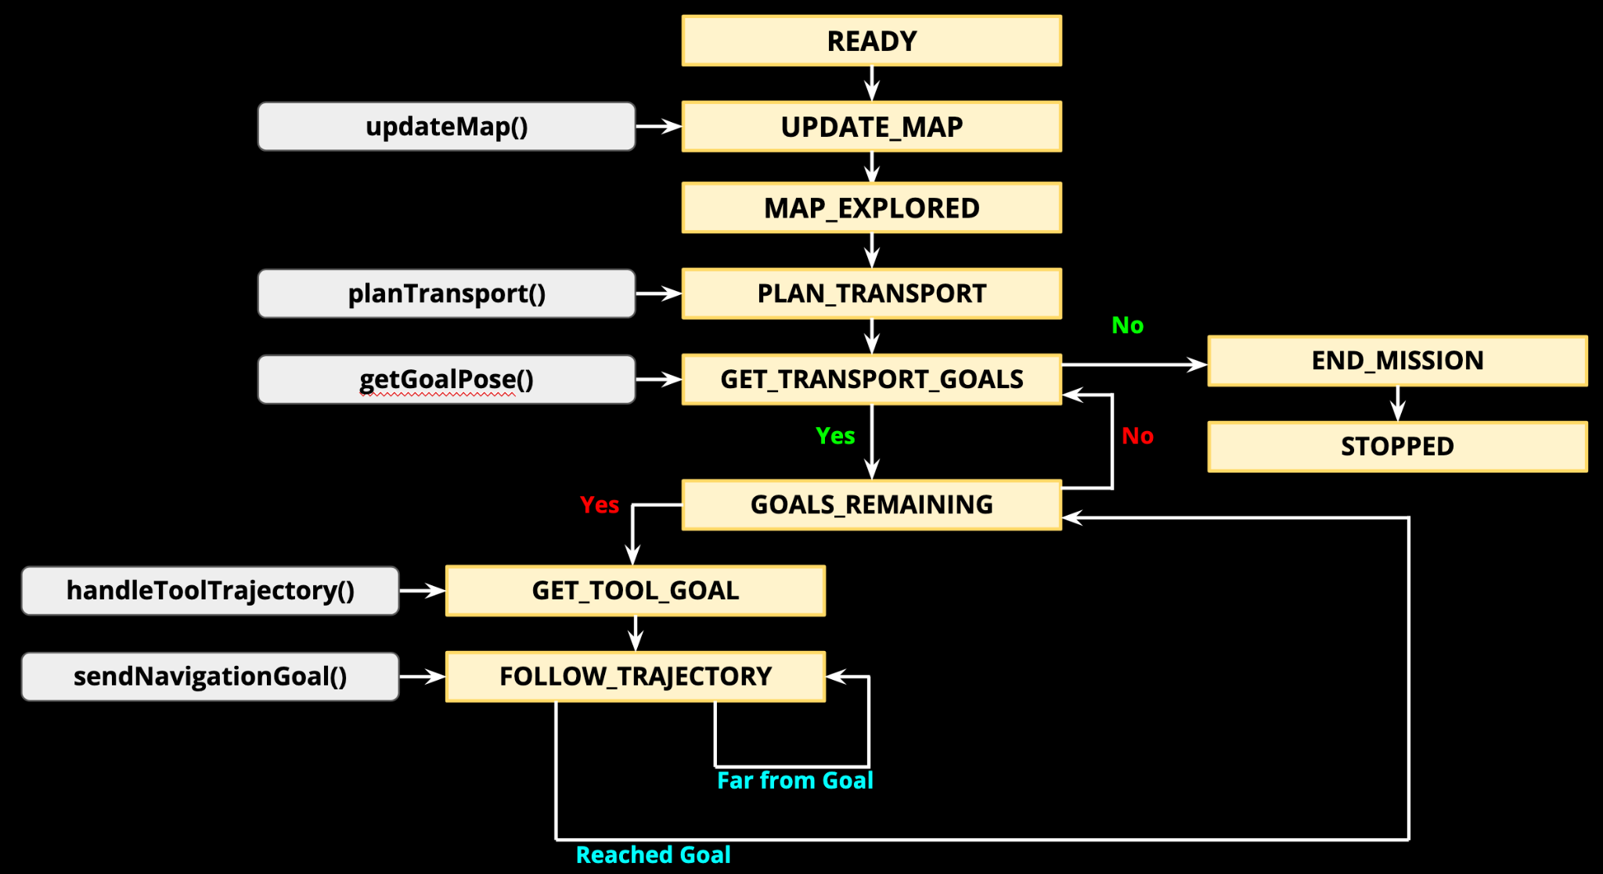
Description: Computations Subsystem
Finite State Machine Unit
Description: High level behaviour tree for entire autonomy stack
Requirements:
Sensors subsystem
Computations subsystem
External infrastructure
Mechanical subsystem
Actuation subsystem
Electrical power subsystem
Expected Functionality:
Entire system is able to grade craters autonomously

Slide 42
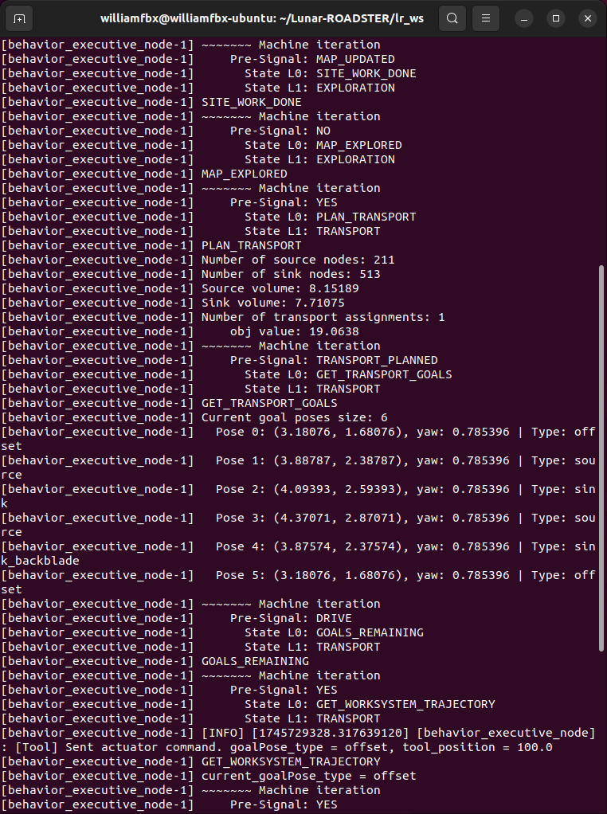
Status: Computations Subsystem
Finite State Machine Unit
Implementation:
FSM callbacks implemented at 2 Hz
Heavy computations parallelized and detached from main thread to not block FSM node from iterating
Challenges:
Compute not sufficient for active mapping using RealSense
Status: 95% Complete
Integrate validation unit into FSM – Fall Goal

Slide 43
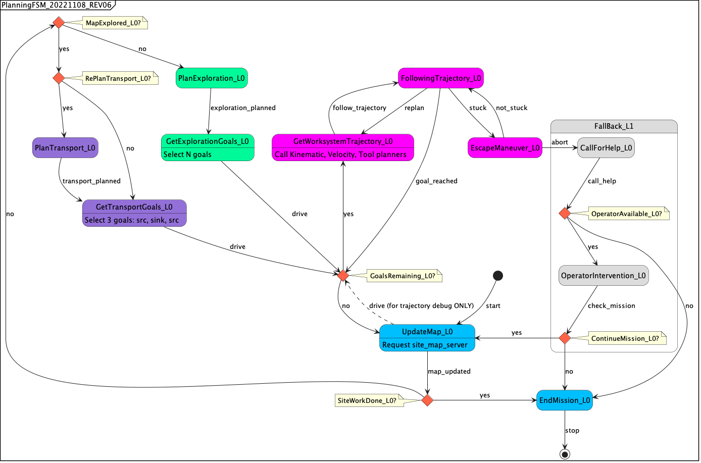
Evaluation: Computations Subsystem
Finite State Machine Unit
Modelling:
Initial FSM design sourced from Crater Grader. Adapted design for our needs
Analysis:
Computations take too long. Rover often completely stops for calculations
Integrating active mapping sometimes causes topic messages to be missed due to high network layer traffic
Testing:
T13: Integration Test
T15: Spring Validation Demo Test

Slide 44


Description: External Infrastructure Subsystem
Description: Mission components deployed offboard the rover to support localization and communication
Requirements:
Leica TS16 Total Station
NVIDIA TX2 Relay Chip
LAN Router
Team laptop (operations terminal)
Expected Functionality:
Accurately localize {X, Y, Z}-coordinates of the rover inside Moon Yard
Establish two-way communication
Notes:
The external infrastructure involves all mission components that are not on the rover. It is responsible for accurately localizing position of the rover inside the MoonYard.

Slide 45

Status & Evaluation: External Infrastructure Subsystem
Implementation:
Total Station sends rover coordinates to TX2 relay chip, forwards data packet via LAN network to rover
Established static IP on LAN network so operations terminal can communicate via SSH
Challenges:
Unable to obtain access to the TX2 relay chip login details
Incorrect Jetson Docker network permissions blocked two-way communication
Status: Completed
Analysis: Investigated network permission issues inside Jetson Docker
Testing: T05: External Infrastructure Test
Notes:
Our implementation involves communication using a TX2 relay chip to the onboard Jetson. The challenges we faced our network permission and establishing static IP. The work in this subsystem is completed.

Slide 46

Description: Mechanical Subsystem
Dozer Assembly
Description: Lunar terrain manipulation tool
Requirements:
Dozer blade
Dozer arms assembly
Linear actuator
Arduino Due
Expected Functionality:
Perform dozing of sand
Perform backblading
Actuate automatically based on commands from tool planner
Notes:
Dozer Assembly is our lunar manipulation tool that will automatically perform dozing and backblading of sand based on commands from the tool planner.

Slide 47

Status: Mechanical Subsystem
Dozer Assembly Unit
Implementation:
Research: Dozer shapes and sizes, actuation methodologies.
Designed the dozer assembly (blade, arms, yoke, mounts) using SolidWorks.
Shortlisted linear actuators of different gear ratios.
Manufactured and assembled all parts on the rover.
Testing with different actuators
Challenges:
Fabrication problems
Limited access to FRC Workshop
Status: 90% Complete
Demonstrated automatic dozing and backblading capabilities of the assembly in SVD
Refine the assembly by remanufacturing certain components
Notes:
Our implementation involved research, mechanical design and manufacturing the dozer. The challenges we faced are fabrication issues and limited workshop access. The task remaining is refining the dozer assembly.

Slide 48

Evaluation: Mechanical Subsystem
Dozer Assembly Unit
Excellent pushing and grading capability, owing to the shape and size of the blade, and the robust dozer arms
Improved yoke/actuator arch to be manufactured in Fall based on the actuator
Notes:
These videos the development progress through iterative design.

Slide 49

Description: Wheel Assembly Unit
Description: Assembly that enables movement of the rover by acting as an interface between the drivetrain and ground.
Requirements:
Wheel (3D Printed - PLA)
Mounting Assembly to the Suspension
Drive Train (Differential and Steering)
Motors
Expected Functionality:
Provide required traction for movement and grading of sand
Minimize wheel slip
Allow for steering in sand
Desirable - Use materials that can function on the Lunar Surface
Notes:
Due to the low-friction Lunar terrain, we modified our wheel design with a focus on maximizing traction, minimizing slip and allowing for efficient steering.

Slide 50


Status: Wheel Assembly Unit
Implementation:
Design single-part iterations in SolidWorks
3D-print designs and test in the MoonYard
Observe and re-design until the design is satisfactory
Challenges:
3D Printing the wheel is a long process with frequent failures
Steering system of the rover is fragile and frequently disengages - solved.
Status: 90% Complete
Demonstrated mobility and pushing power with 4 printed wheels in SVD
Next iteration in Fall to make the design lighter.
Integration of current sensing to measure wheel torque.

Slide 51
Evaluation: Wheel Assembly Unit
Great performance in traction and generating pushing power in all tests Torque feedback to be integrated in the Fall to estimate traction and slip Design can be optimized to be lighter - Fall goal

Slide 52

Description: Actuation Subsystem
Description: Power transfer methodologies for rover mechanisms.
Requirements:
DC Motors with Encoders (x4)
Linear Actuator (with feedback)
Expected Functionality:
Deliver power to wheels for mobility
Steer the front and rear wheels
Actuate the dozer assembly to facilitate mobility and dozing
Notes:
The actuation subsystem is responsible for delivering power to all motors and actuators.

Slide 53


Status: Actuation Subsystem
Implementation:
Selected drive motors with higher torque for better traction and mobility
Selected linear actuator for dozer assembly
Interfaced drive motors and steering motors with Roboclaw motor controller
Interfaced Actuator with Linear Actuator Controller Board and Arduino Due
Challenges:
Mismatched gearing in motors caused non-uniform steering in front and rear
Worn-out pinion gears
Oscillations near setpoint of linear actuator under load.
Status: 90% Complete
Demonstrated enhanced steering and driving in SVD
Upgrade/tune linear actuator
Notes:
Our implementation involves sourcing and interfacing actuators using their respective drivers. The challenges we faced are mismatched gearing in front and rear steering motors and minimising actuations. Our next task involves tuning the PID to minimize actuator oscillations.

Slide 54

Evaluation: Actuation Subsystem
New drive motors provide adequate motion in the Moonyard. Actuator has the capability to lift the rover, as demonstrated in SVD. Replace actuator for better and smoother performance - Fall goal
Notes:
These videos the development progress through iterative design.

Slide 55

Description: Electrical Subsystem
Description: Rover’s power and logic circuitry.
Requirements:
Buck Converter (20 V -> 12 V)
Power Distribution Board (PDB)
RoboClaw Motor Controller - 2
Linear Actuator Controller
Linear Actuator
Zed 2i Depth Camera
E-Stop
Wireless Switch
IMU - VectorNav VN100
Arduino Due
Nvidia Jetson Xavier AGX
Wireless Receiver for Joystick
DC motors with Encoders
Expected Functionality:
Distribute power efficiently to all rover components
Ensure stable voltage levels for uninterrupted operation
Electrical Circuitry
Notes:
The electrical subsystem is the rover’s power and logic circuitry. It ensures stable voltage levels for robust operation.

Slide 56

Status: Electrical Subsystem
Implementation:
Integrated new electrical components and designed a custom Power Distribution Board (PDB) based on updated power requirements
Designed a compact and accessible electronic box to streamline the electrical subsystem setup
Successfully integrated and tested the PDB within the rover’s electrical system
Challenges:
Understanding and adapting to the existing circuit design and limitations.
Ensuring the compact design of the electronic box while maintaining accessibility and proper cooling.
Status: 90%
Integrating torque feedback sensing and updating battery position – Fall Goal
Notes:
analyzed existing connections and modified them to our requirements.
designed a compact electronics box to minimize space taken and maximize accessibility.
main challenge was to ensure that the box design allows for proper cooling

Slide 57


Evaluation: Electrical Subsystem
Modeling:
Developed detailed circuit diagram integrating existing and new electrical components
Modeled custom PDB with over-current, reverse-voltage, and power indication features
Designed electronics box for minimal footprint, cooling, and accessibility
Analysis:
Verified voltage and current demands for each subsystem component to ensure PDB output stability
Assessed cable routing and hardware quality assurance
Testing:
T07: Complete Hardware Test

Slide 58
Performance Evaluation in SVD
What went well?
What didn’t go well?
What needs to improve?
Mechanical Design
Electronics Box Design
Transport Planner
Navigation Planner
Finite State Machine
Reliability of Autonomy
Demonstrating Performance Metrics
System Improvement for Encore
Codebase (Bloated, heavy compute)
Localization Accuracy
Wiring
Pre-demo setup methodology
Notes:
Based our eval around 3 questions
We figured that our Hardware (Mech and Elec) was well designed and built.
Transport Planner and Nav were seamlessly integrated through a central FSM.
We should’ve spent more time testing and integrating the new features for encore, to improve reliability of autonomy and demo PMs

Slide 59
Performance Evaluation in SVD
Req. | Description | Status | Score
M.P.1 | Cumulative deviation from latitude | Achieved - Global path planning methodology has been set up. We were only able to demonstrate a straight line for a single crater. | 5/10
M.P.2 | Navigation Accuracy | Demonstrated - The ROADSTER followed the generated global path to an average deviation of 8.16%. Metric will also improve with localization. | 9/10
M.P.4 (Part 1) | Crater Avoidance | Demonstrated - Methodology for identification of craters to avoid set up. Shown in sim during SVD | 8/10
M.P.5 | Crater Grooming | Demonstrated - Groomed craters in both autonomous and teleop. Built a strong, capable machine for crater grooming | 10/10
Notes:
Setup a scoring system to evaluate the performance

Slide 60
Performance Evaluation in SVD
Req. | Description | Status | Score
M.N.1 | Weight | Achieved - The rover weighs 25kg. This number may increase with additions during the Fall. Need to demonstrate. | 8/10
M.N.4 | Size | Missed - The size of the dozing arms were increased to allow for backblading. The battery mounting extension arms need to be removed to meet this requirement. | 3/10
D.N.1 | Technological Extensibility | Achieved - We have maintained an Engineering Wiki and extensively documented our entire design process. Need to demonstrate. | 8/10
D.N.2 | Aesthetics | Demonstrated - Sponsor requirement. Design look is satisfactory with minor changes in cable management and colour schemes | 9/10
Notes:
Some NFM that we targetted were also scored. Only talk about missed

Slide 61
Performance Evaluation in SVD
Presentation / Management
9/10
Hardware
9/10
OVERALL 8/10
Software
6/10

Slide 62

Video Excerpt

Slide 63
Conclusions after SVD
WEAKNESSES
Mechanical Vulnerability
Electrical Unreliability
Compute Bottleneck
Reliability of autonomy
Demonstrating performance metrics
STRENGTHS
Robust Tool Subsystem
Compact E-Box
Wheels
Power Distribution Board (PDB)
Management and Presentation
External Infrastructure
Software Integration
Notes:
Robust Tool Subsystem: The dozer assembly is well-built and effective
Compact E-Box: New E-box is an efficient and an accessible casing
Wheels: Reliable wheels support superior traversability
Power Distribution Board (PDB): Well-organized, protected, and reliable in distributing power to various subsystems
Management and Presentation
External Infrastructure: The TX2 relay worked fine to our satisfaction to transmit xyz tracked by the Total Station
Software: The planner and navigation stack were integrated through the FSM and were working seamlessly
Mechanical Vulnerability: Worn-out components posed risks and issues
Electrical: Loose wires caused subsystem failures
Compute Bottleneck: Non-optimized codebase with compute limitations caused computational delays
Reliability of autonomy: inconsistent stability in autonomy, leading to manual interventions
Demonstrating performance metrics: Difficulty in showcasing performance results

Slide 64
PROJECT MANAGEMENT

Slide 65

Work Breakdown Structure
Notes:
Broadly based on our subsystems
Grader not required, backblading instead
PDB in electronics is new, Read Sensor Data using Jetson in Sense is new

Slide 66
Schedule
Major Milestones:
All major spring milestones completed ahead of SVD
Systems require improvement to meet FVD goals
Current Status:
Achieved all promised goals for SVD
Slight delays due to additional development for SVD Encore (higher compute requirements)
Plan to Improve:
Upgrade to a higher-performance Jetson during summer
Make final system adjustments to ensure system robustness before PR6

Slide 67
Fall Test Plan
Date | Event | Capability Milestones | Tests | Requirements
09/10 | PR7 | Hardware and software refinement | Validate hardware upgrades, software fixes, and system stability improvements | M.F.5 M.F.9 M.N.3
09/24 | PR8 | Validation stack setup Wheel torque measurement Navigation tuning | Detect robot stalling through torque measurement, adjust tool height, and verify smooth navigation through path execution tests | M.F.2 M.F.3 M.F.4 M.F.8 M.F.9
10/08 | PR9 | Autonomous grading of multiple craters | Verify autonomous grading performance across multiple craters | M.F.2 M.F.3 M.F.4 M.F.5 M.F.6 M.F.7 M.F.9
Notes:
System refinement based on issues identified during SVD such as Jetson replacement, linear actuator and wheel upgrades, hardware improvements, code optimization, namespace corrections, runtime complexity reduction, ZED camera integration with Jetson Docker
Validation stack setup, wheel torque measurement to detect stalling and adjust tool height, and navigation stack tuning for optimal path planning and smooth robot motion.
Grading of multiple craters with autonomous rover operation

Slide 68
Fall Test Plan
Date | Event | Capability Milestones | Tests | Requirements
10/29 | PR10 | SkyCam-based localization for improved global positioning | Test SkyCam-based localization by checking rover’s ability to self-localize accurately with / without external infrastructure | M.F.3
11/12 | PR11 | Full system integration Quality assurance testing | Check all subsystems and units are functioning correctly | M.F.2 M.F.3 M.F.4 M.F.5 M.F.6 M.F.7 M.F.8 M.F.9
11/17 11/24 | PR12 (FVD and FVD Encore) | Final system demonstration involving autonomous grading of multiple craters | Demonstrate full autonomous operation by detecting, avoiding ungradable craters, and grading multiple suitable craters according to mission specs | M.F.1 M.P.1 M.F.2 M.P.2 M.F.3 M.P.3 M.F.4 M.P.4 M.F.5 M.P.5 M.F.6 M.P.6 M.F.7 ……. M.F.8 ……. M.F.9 …….

Slide 69
Fall Validation Demonstration
Test Location
Planetary Robotics Lab Moon Yard
Sequence of Events
Prior Setup: Prepare the Moon Yard with several craters and dunes in a circular path. Scan the Moon Yard with a FARO Scanner to obtain a global map for navigation. Attach and connect all the components and subsystems of the rover. Place the rover in the Moon Yard and calibrate its localization using a star-sun tracker, visual odometry, and/or total station. During Demonstration: Switch the rover to autonomous mode and use goal poses with offsets to plan the path. Observe the rover autonomously grade craters and level dunes in a circular path. After each dozed crater, use the ZED camera to validate whether the dozing satisfies the performance requirements. If anything unexpected occurs press the emergency stop button.
Quantitative Performance Metrics
M.P.1: Will plan a path with cumulative deviation of <= 25% from chosen latitude’s length M.P.2: Will follow planned path to a maximum deviation of 10% M.P.3: Will climb gradients up to 15° and have a contact pressure of less than 1.5 kPa M.P.4: Will avoid craters >= 0.5 metres and avoid slopes >= 15° M.P.5: Will fill craters of up to 0.5 meters in diameter and 0.1m in depth M.P.6: Will groom the trail to have a maximum traversal slope of 5°
Follow a circular path
Groom several craters in a circular path

Slide 70

Budget
Major Items | Units | Total Price
ZED 2i Stereo Camera | 1 | $562.00
DC/DC Power Converter | 1 | $315.51
Linear Actuators | 3 | $290.00
Planetary Gear Motors | 4 | $239.96
MRSD Budget | MRSD Budget Spent ($) | MRSD Budget Spent (%) | Total Budget Spent* | Remaining Balance
$5,000 | $2,309.07 | 46.2% | $5,379.07 | $2690.93
* Includes items inherited from Crater Grader and Supervisor

Slide 71

Risk Management (Updated)
Risk Summary
R10, R31, R32
R14
R2, R11
R19
R12, R24, R29
R30
R5, R7,
R20, R23,
R26, R27
R16, R28
R3, R6
R1
Notes:
This is our updated risk summary

Slide 72
Risk Management (Updated)
Reduced Risk Summary
R14
R10, R31
R2, R30
R5, R12, R19, R23, R27, R29, R32
R3, R6, R11
R26
R24, R28
R7
R20
R1, R16
Notes:
This is our updated reduced risk summary, allowing us to focus on the crucial ones

Slide 73
Top Risks
Risk ID | Risk Title | Risk Owner | Risk Type: | Technical, Logistics
R28 | Electrical Hardware Finalization | Ankit
Description |  | Date Added
E-box Design dependence on to-be manufactured PDB. |  | 2/14/2025
 |  | Date Updated
 |  | 4/06/2025
Consequence
Not meeting the hardware deadline
Action/Milestone |  | Success Criteria | Date Planned | Date Implemented
Use previous knowledge and account for a placeholder in the design. |  | Successfully design and manufacture E-box compatible with the new PCB using placeholder PCB design | 02/14/2025 | 04/06/2025
Order PCB and components (and spares) outside of MRSD schedule |  | Successfully order and assemble the PCB | 03/26/2025 | 04/04/2025
Notes:
We've also recognized additional risks, such as finalizing electrical hardware, which depends on PDB design and could delay hardware completion.

Slide 74
Top Risks
Risk ID | Risk Title | Risk Owner | Risk Type: | Logistics
R29 | Access to FRC Workshop | Deepam
Description |  | Date Added
Without access, no hardware fabrication/repairs can be carried out in the absence of Tim |  | 2/7/2025
 |  | Date Updated
 |  | 2/7/2025
Consequence
Not meeting the hardware deadline
Action/Milestone |  | Success Criteria | Date Planned | Date Implemented
Try other fab-labs on campus. |  | Successfully access other fab-labs and manufacture components | 2/9/2025 | 4/4/2025
Request Tim, John or Red for getting temporary access, if not permanent |  | Successfully get temporary/permanent access to FRC Workshop | 2/12/2025
Notes:
Restricted workshop access could slow down future manufacturing tasks.

Slide 75
Top Risks
Risk ID | Risk Title | Risk Owner | Risk Type: | Logistics
R30 | No spares available | Team
Description |  | Date Added
Discontinued model, spare parts unavailable |  | 3/4/2025
 |  | Date Updated
 |  | 4/10/2025
Consequence
The whole project falling through, or redo almost all subsystems on a different rover.
Action/Milestone |  | Success Criteria | Date Planned | Date Implemented
Check out eBay and other similar platforms for spares |  | Successfully find exact spares on these platforms | 3/6/2025
Check out and stock similar parts if not same |  | Successfully find and stock similar parts | 3/6/2025
Find a twin rover that was used by a previous team on campus |  | Successfully find the twin rover and scavenge parts | 3/6/2025 | 3/7/2025
Maintain all parts, especially mechanical parts |  | Successfully avoid future breakdowns and part failures | 3/7/2025 | 4/10/2025
Notes:
This is a recent and critical risk which is a consequence of an issue we faced last week. We noticed that one of the rear axles was broken and basically disengaged from the driveline.The spares are unavailable since the model is discontinued. Thanks to Red and Chuck, we found a twin rover for parts, but this remains a top concern as run a risk of the project falling through.

Slide 76
Top Risks
Risk ID | Risk Title | Risk Owner | Risk Type: | Technical
R31 | Localization frame shift after total station battery swap | Bhaswanth
Description |  | Date Added
Battery replacement in the total station causes small frame offsets, leading to localization inaccuracies. |  | 3/4/2025
 |  | Date Updated
 |  | 4/10/2025
Consequence
Leads to poor navigation performance and risk of missing the crater during grading operations.
Action/Milestone |  | Success Criteria | Date Planned | Date Implemented
Implement resection method using three known prism locations instead of orientate-to-line |  | Successfully fix the frame consistently after battery swaps | 4/26/2025
Explore and test alternative localization methods (using SkyCam) |  | Successfully maintain localization accuracy | 4/26/2025
Notes:
This is a recent and critical risk which is a consequence of an issue we faced last week. We noticed that one of the rear axles was broken and basically disengaged from the driveline.The spares are unavailable since the model is discontinued. Thanks to Red and Chuck, we found a twin rover for parts, but this remains a top concern as run a risk of the project falling through.

Slide 77
Top Risks
Risk ID | Risk Title | Risk Owner | Risk Type: | Technical
R32 | Arduino requires reset before operation | Bhaswanth
Description |  | Date Added
Arduino needs to be manually reset each time before starting autonomy or switching between autonomy and teleoperation modes. |  | 3/4/2025
 |  | Date Updated
 |  | 4/10/2025
Consequence
Slows down setup time and impacts operational readiness, delaying mission start and mode transitions.
Action/Milestone |  | Success Criteria | Date Planned | Date Implemented
Check USB port permissions and drivers issues on Jetson |  | Successfully establish consistent serial connection without reset | 4/26/2025
Verify that Arduino is connected via USB 3.0 instead of USB 2.0 port |  | Ensure stable high-speed communication | 4/26/2025
Check for ROS node frequency mismatches causing packet loss to Arduino |  | Match ROS publish/subscribe rates | 4/26/2025

Slide 78
Lessons Learned
Fall Activities
Check for common issues online while choosing hardware (Jetson and Zed issue)
Schedule based on resource availability such as lab access and lead times
Plan for Progress Review goals at the beginning of the semester
Have a proper plan for demo split between SVD and SVD Encore
Do not choose a project where you have to build both software and hardware from scratch :)
Integrate and test continuously
Improve tool actuator
Wheel torque feedback
Tune overall software stack
Solution to compute problem (new Jetson/code optimization)
New localization method - SkyCam
Planning for grooming multiple craters
Notes:
As part of our reflections from this semester, we identified several important lessons learned.
First, it's important to check for common issues online during the component selection phase.
Second, scheduling based on resource availability — such as lab access, and lead times for parts — is critical.
Third, it’s important to plan Progress Review goals right at the beginning of the semester. This way, we can align our development milestones better with the review deadlines, rather than scrambling to meet them last-minute.
Another key learning is to have a proper plan for splitting the demo between SVD and SVD Encore. Trying to deliver everything during SVD itself left very little flexibility for encore improvements, and led to rushed demonstrations.

Slide 79


Colonize the Moon!
Team Lunar ROADSTER
Any Questions? 🤖🦾🚀
“Starting with a foothold on the Moon, we pave the way to the cosmos”

Slide 80

Thank You!
https://mrsdprojects.ri.cmu.edu/2025teami/

Slide 82
Appendices
A.1. Derivation for M.P.5:
Chang’e-4’s landing site was surveyed and found that 97.5% of nearby craters were below 15.5 meters in diameter.
Our rover is approximately 1/30th the size of a commercial grader, so it shall be able to grade 15.5/30 ≈ 0.5 meter craters at least.
Source: DOI 10.3390/rs14153608
A.2. Derivation for M.P.3:
Average depth-to-diameter (DtoD) ratio of 0.07 near the North pole
Assuming worst-case scenario of a crater with twice DtoD ratio of 0.14, the gradient is θ = arctan(0.14*2) ≈ 15 degrees
Contact pressure requirement follows recommendation from NASA
Source: DOI 10.1029/2022GL100886, NASA/TP—2006–214605
A.3. Derivation for M.P.1:
Recommendation from Nature paper on extraterrestrial path-planning metrics
Source: DOI 10.1038/s41598-023-49144-8
Credits for images:
Generative AI
Google Images
Dr. William Red Whittaker’s slides

Slide 83
Risk Management (Extra)
Risk ID | Risk Title | Risk Owner | Type | Description | Consequence | Risk Reduction Plan
R1 | PRL Testbed Scheduling | Ankit | Scheduling | PRL Testbed unavailable due to scheduling conflicts with other high priority projects | No testbed available for testing and/or SVD | Devise and discuss a testing and demo plan with Red and other stakeholders of the PRL testbed beforehand and reserve slots
 |  |  |  |  |  | Reach out to external testing facilities like Astrobotic or CAT for a backup testing facility
 |  |  |  |  |  | Schedule tests at night
R2 | Excavator and grader tool planner takes longer than expected to deliver | Simson | Technical | Integration of the excavator and grader software with hardware takes longer than expected | Unable to meet SVD deadline and potential requirements change | Shift requirements for SVD
 |  |  |  |  |  | Integrate the grader during Fall semester
 |  |  |  |  |  | Potentially use off-the-shelf code if available, preferably from CraterGrader
R3 | Integration issues between subsystems | Deepam | Technical | Subsystems work individually, but integration and communication between the subsystems are flawed | Delay in integration causing scheduling overruns, requirements change and failure of the demo | Perform unit testing and subsystem validation continuously
 |  |  |  |  |  | Integrate one subsystem at a time
 |  |  |  |  |  | Use a common framework (e.g. ROS2 interfaces) for communication between subsystems to reduce bugs
 |  |  |  |  |  | Keep to planned schedule and have at least 5 weeks for testing and integration
R4 | Belly depth sensor is not suitable for validation | Bhaswanth | Technical | The belly depth camera is used to validate if a groomed crater is satisfiable. The sensor may not be able to adequately determine depth variations suitable for validation | Will result in major revision and changes to the validation architecture and functional requirement, causing delays in scheduling | Mount the depth camera at another location on the rover (e.g. on a mast)
 |  |  |  |  |  | Use another sensor to determine depth variations (e.g. LIDAR, visual odometry, IR sensor)
 |  |  |  |  |  | If all else fails, use the total station for validation

Slide 84
Risk Management (Extra)
Risk ID | Risk Title | Risk Owner | Type | Description | Consequence | Risk Reduction Plan
R5 | Unable to get Crater Grader to perform autonomous crater filling | Bhaswanth | Technical | Our rover builds on top of the work accomplished by Crater Grader. If we cannot get Crater Grader to perform autonomous crater filling, we may need to spend more time working on the navigation stack and designing the entire pipeline | Extra time commitment to start from scratch or obtaining a suitable replacement | Thoroughly go through Crater Grader's code and the mechanical schematics provided
 |  |  |  |  |  | Test each component and wiring to see if they are working
 |  |  |  |  |  | If it is still not working, inherit only the software component from Crater Grader and build hardware ourselves
R6 | Delay in arrival and manufacture of hardware components | William | Schedule | Shipping delays of components ordered and/or manufacturing delays on custom made components | Delays in hardware integration, causing pushbacks in scheduling and software development | Use off-the-shelf components that are available on hand (e.g. from CMU labs or Red's workshop)
 |  |  |  |  |  | Start ordering and designing components during Winter break so there is adequate leeway for delivery and manufacturing before Spring semester starts
 |  |  |  |  |  | Use simulations to work on software components while we wait for the components to be delivered and/or manufactured
 |  |  |  |  |  | Implement other subsystems that are independent from the subsystem that is missing parts
 |  |  |  |  |  | In case of delay in wheels, work with the existing wheels and proceed with the timeline while waiting for the new ones to arrive.
R7 | Lack of proper simulation environment | Simson | Technical | Inability to accurately simulate the rover in a Lunar-like environment can lead to suboptimal performance | The rover's performance in the Moon Pit may be compromised, leading to inefficiencies, mission delays, or potential failure in achieving key objectives | Ask CraterGrader how they ran all their simulations and gather resources
 |  |  |  |  |  | Explore LunarSim - https://github.com/PUTvision/LunarSim and check how useful this will be, during the winter break
 |  |  |  |  |  | Develop Gazebo environment

Slide 85
Risk Management (Extra)
Risk ID | Risk Title | Risk Owner | Type | Description | Consequence | Risk Reduction Plan
R10 | Mast depth camera FOV is blocked | William | Technical | Mast depth camera's FOV can be blocked, partially or completely, due to dust, misalignment of camera, or interference from the rover's own excavator assembly. | Hinders the rover's ability to perceive its surroundings accurately, resulting in navigation errors and inefficiencies in excavation tasks | Conduct field tests to choose an optimal height to place the depth camera such that dust does not reach it and it can clearly see in front of the rover, despite the excavator assembly. Ensure that visual data such as depth perception and object detection should not be compromised
R11 | Too many performance requirements | Ankit | Technical, Schedule | We have a lot of performance requirements and we may not be able to meet all of them by April for SVD | Delays in testing and validation, impacting project timelines and April SVD Demo results | Have revised performance requirements separately for SVD and FVD (focus more on SVD)
 |  |  |  |  |  | Talk to CraterGrader and discuss what is feasible and what is not in the given time
 |  |  |  |  |  | PM should track schedule properly and team members have to push to meet the timeline
R12 | Drive system wear-and-tear causes malfunction | Deepam | Technical | The transmission and steering assembly might be worn out, leading to suboptimal vehicle dynamics, and potentially mechanical failure | Rover drive system fails and may require a lot of repair and maintenance | Thoroughly check the Crater Grader's assembly and carry out maintenance of any worn-out parts
 |  |  |  |  |  | Completely replace the assembly parts with the same/similar new parts for better performance and reliability
 |  |  |  |  |  | Added limit switches to avoid steering gears to operate beyond their limits
R14 | Dust ingress | William | Technical, Cost | Due to significant sand manipulation, the flying sand/dust can enter and accumulate over sensitive electronics (PDB, drivers, Arduino) and sensors (cameras, IMU), leading to component failure or incorrect sensing | Component failure during testing or demonstrations. Highly inhibits all future scheduled tasks | Design proper sand enclosures and mounts for sensitive components
 |  |  |  |  |  | Review placement of components
 |  |  |  |  |  | Review scale and speed of sand manipulation to eliminate root-cause of flying sand/dust
 |  |  |  |  |  | Allocate contingency budget and order spares of the sensitive components in case of component failure

Slide 86
Risk Management (Extra)
Risk ID | Risk Title | Risk Owner | Type | Description | Consequence | Risk Reduction Plan
R16 | Code version control | Simson | Technical | Code modifications or config parameter changes during testing might not be saved, affecting the final demo. Reverting to a stable version is difficult if changes do not work as expected. | Delay in code integration and implementation | Implement GitHub version control to store and retrieve the best versions of code and configuration
 |  |  |  |  |  | Use Google Drive to backup important documentation explaining setup processes
R19 | Items missing | Ankit | Logistics | Critical project items may go missing if not stored properly or tracked. Items may be misplaced or borrowed without proper logging | Delay in hardware implementation | Maintain an inventory tracking spreadsheet
 |  |  |  |  |  | Include spare inventory
R20 | Sensor ROS packages not available | William | Technical, Schedule | Finalized sensors might lack compatible ROS packages, leading to delays or significant changes in the software architecture | Delay in software implementation | Perform trade studies to pick sensors that are compatible with ROS versions before finalizing
 |  |  |  |  |  | Select sensors and ROS versions that minimize potential conflicts
R23 | Lunar-accurate cut/fill regions are not possible to groom | Simson | Technical | The rims of the craters may not be enough to fill the whole crater. Going to a different region to carry the sand to the crater may prove to be inefficient | The basic assumption of sand availability fails. We may need to rethink the basic concept of tool planner to fit the new parameters of the environment | Accurately create the environment and assess if the rims are enough to fill
 |  |  |  |  |  | If not, modify PRs accordingly

Slide 87
Risk Management (Extra)
Risk ID | Risk Title | Risk Owner | Type | Description | Consequence | Risk Reduction Plan
R24 | Sensor data is too noisy to fulfill performance requirements | William | Technical | Performance requirements are tough and ambitious, sensor noise may prevent us from achieving it | Failure to demonstrate performance requirements may cause us to lose marks in the demonstrations | Relax the performance requirements enough to ensure that they are achievable
 |  |  |  |  |  | Ensure enough testing time to tune parameters
R26 | Off-the-shelf wheels don't interface with the rover | Ankit | Technical | No off-the-shelf wheels fit the rover, We'll have to redesign wheel hubs and mountings as per the new wheels. | Continue with sub-optimal wheels that the rover currently has, thus, not meeting one of the non-functional requirements | Shift requirements to FVD
 |  |  |  |  |  | Good enough market research to see find the best fit, with least amount of changes

Slide 88
Risk Management (Extra)
R27 | TX2 Integration | William | Technical | Unable to login to TX2 and interface with a LAN network for transmitting data over WiFi ro Jetson | Delay in finalizing localization stack | Set up a new TX2 (Re-flash the TX2). Reach out to previous teams to understand their methodology and retrieve credentials
R28 | Electrical hardware finalization | Ankit | Technical | E-box Design dependence on to-be manufactured PDB. | Not meeting the hardware deadline | Use previous knowledge and account for a placeholder in the design
R29 | Access to FRC Workshop | Deepam | Logistics | Without access, no hardware fabrication/repairs can be carried out in the absence of Tim | Not meeting the hardware deadline | Try other fab-labs on campus. Request Tim, John or Red for getting temporary access, if not permanent
R30 | No spares available | Team | Logistics | Discontinued model, spare parts unavailable | The whole project falling through, or redo almost all subsystems on a different rover. | Check out eBay and other similar platforms for spares Check out and stock similar parts if not same Find a twin rover that was used by a previous team on campus Maintain all parts, especially mechanical parts

